Slide 1
Modeling growth in stock assessments using Stock Synthesis
Ian Taylor
CAPAM Growth Workshop
2 November 2014

Slide 2
Outline (approximate)
Parameterization of growth curves
What depends on what
Overview of example models
Timing issues
Advanced topics
Whatever you want to talk about

Slide 3
Notes
Presentation is more diagrams than equations
More SS materials at this Google Drive link
Content for this tutorial at https://github.com/taylori/SSgrowth
Figures created using r4ss package
Still in development, currently requires branch available via the “devtools” package from GitHub:
> devtools::install_github('r4ss/r4ss', ref='TA1.8testing')
Example models referenced at bottom of slides
None of this would exist without Rick Methot

Slide 4
Parameterization of growth

Slide 5
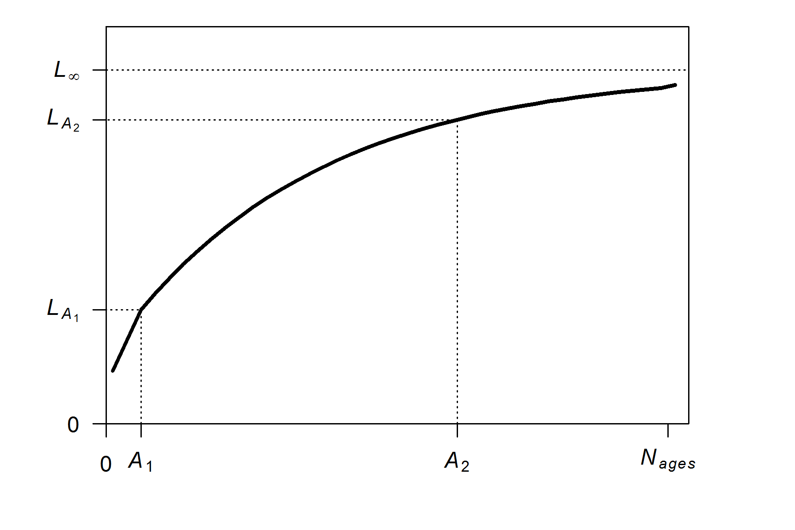
Parameterization of growth: mean length
Von Bertalanffy growth with 2 reference ages
source model: growth_illustration_offset2

Slide 6
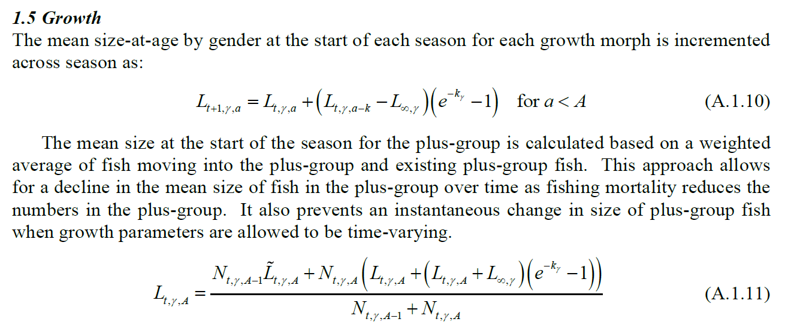
Parameterization of growth: mean length
Von Bertalanffy growth with 2 reference ages
source: Methot_Wetzel_2013_Appendix.pdf (M&W2013)

Slide 7
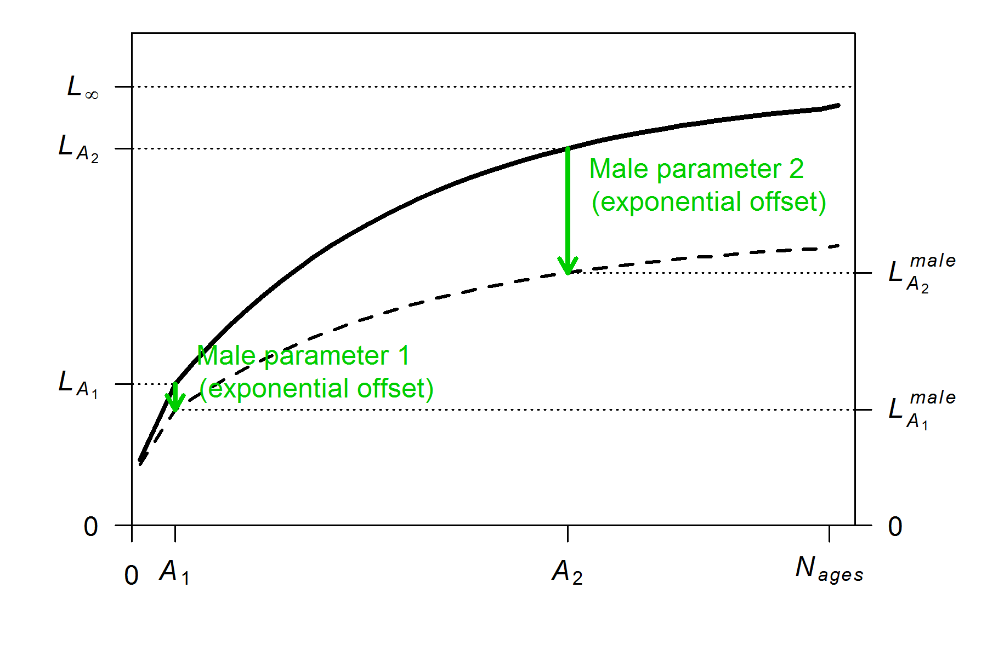
Parameterization of growth: mean length
Male growth can be separate parameters or exponential offsets
source model: growth_illustration_offset2

Slide 8
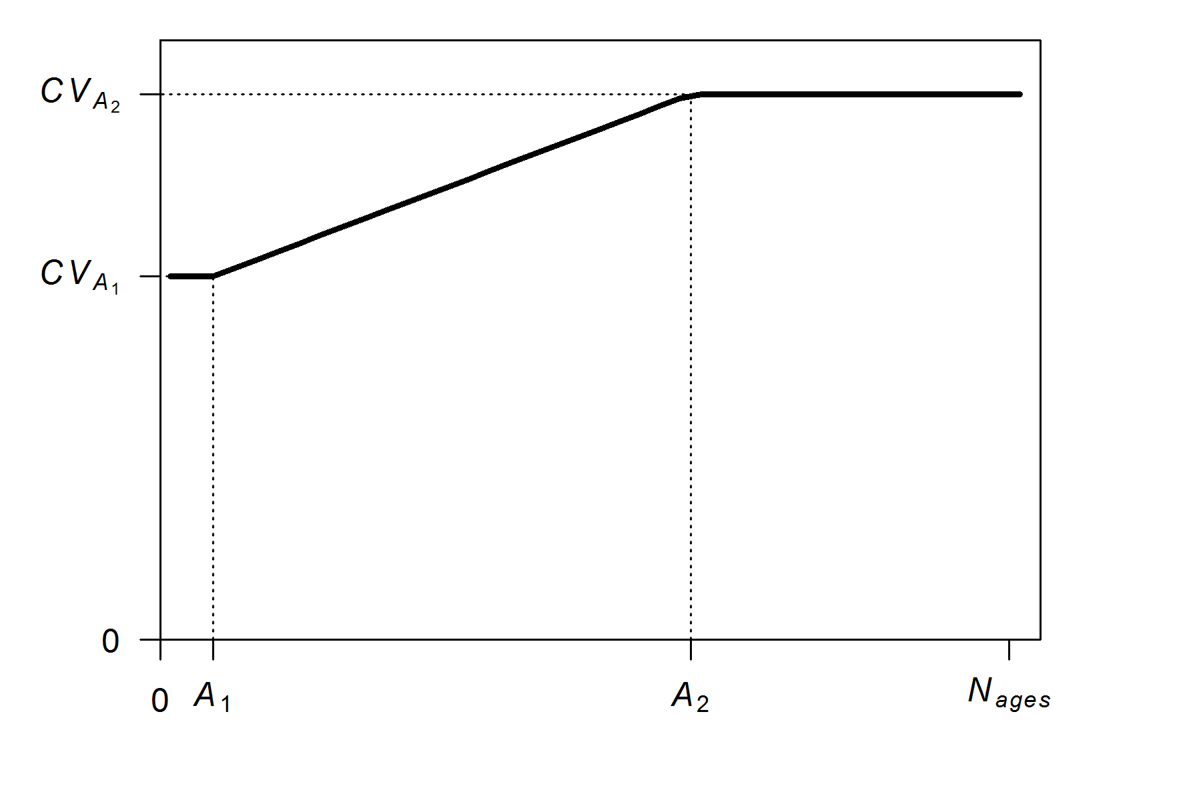
Parameterization of growth: length variability
Variability in length at age determined by 2-parameter “dogleg” function (eq. A.1.13 in M&W2013) (with same reference ages as growth curve)
source model: growth_illustration_offset2

Slide 9
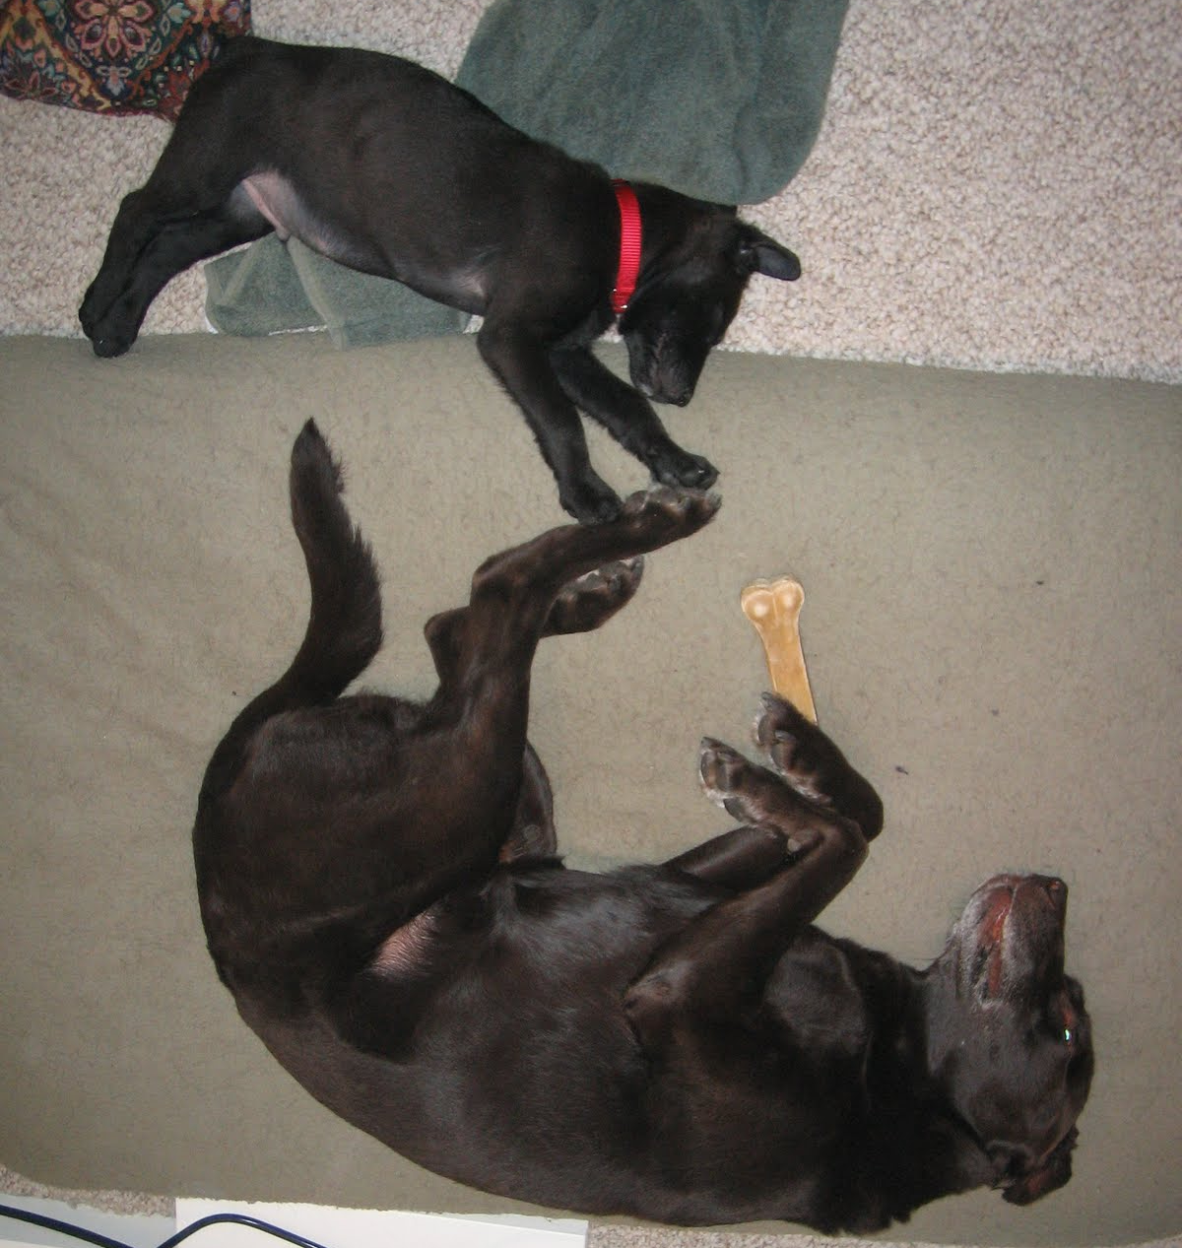
Parameterization of growth: length variability
Variability in length at age determined by 2-parameter “dogleg” function (with same reference ages as growth curve)
source model: growth_illustration_offset2

Slide 10
Parameterization of growth: length variability
CV options for variability:
1 #_CV_Growth_Pattern: 0 CV=f(LAA); 1 CV=F(A); 2 SD=F(LAA); 3 SD=F(A); 4 logSD=F(A)
Can be CV or SD of growth
Can be age or length
source model: growth_illustration_offset2

Slide 11
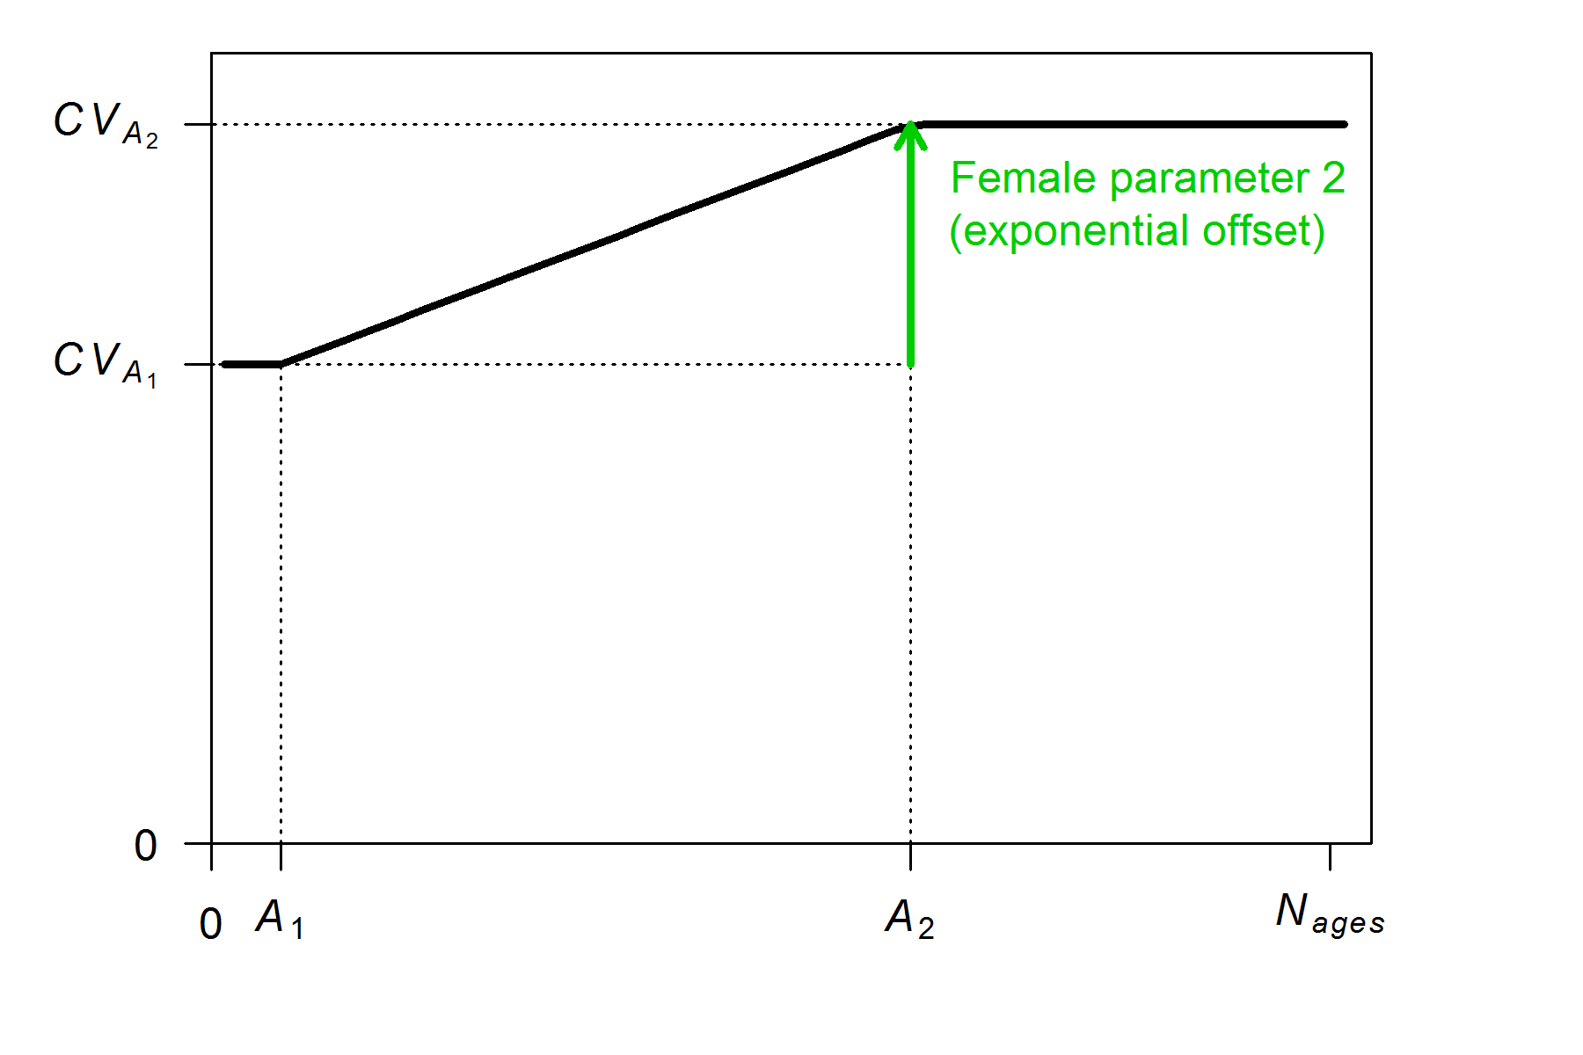
Parameterization of growth: length variability
Offset options for variability:
#_parameter_offset_approach (1=none, 2= M, G, CV_G as offset from female-GP1, 3=like SS2 V1.x)
source model: growth_illustration_offset3

Slide 12
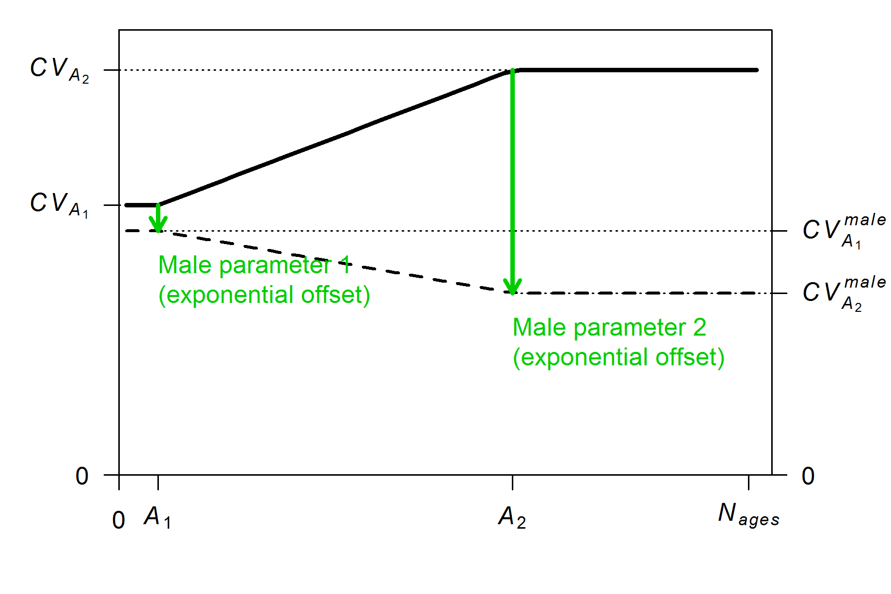
Parameterization of growth: length variability
Offset options for variability:
#_parameter_offset_approach (1=none, 2= M, G, CV_G as offset from female-GP1, 3=like SS2 V1.x)
source model: growth_illustration_offset2

Slide 13
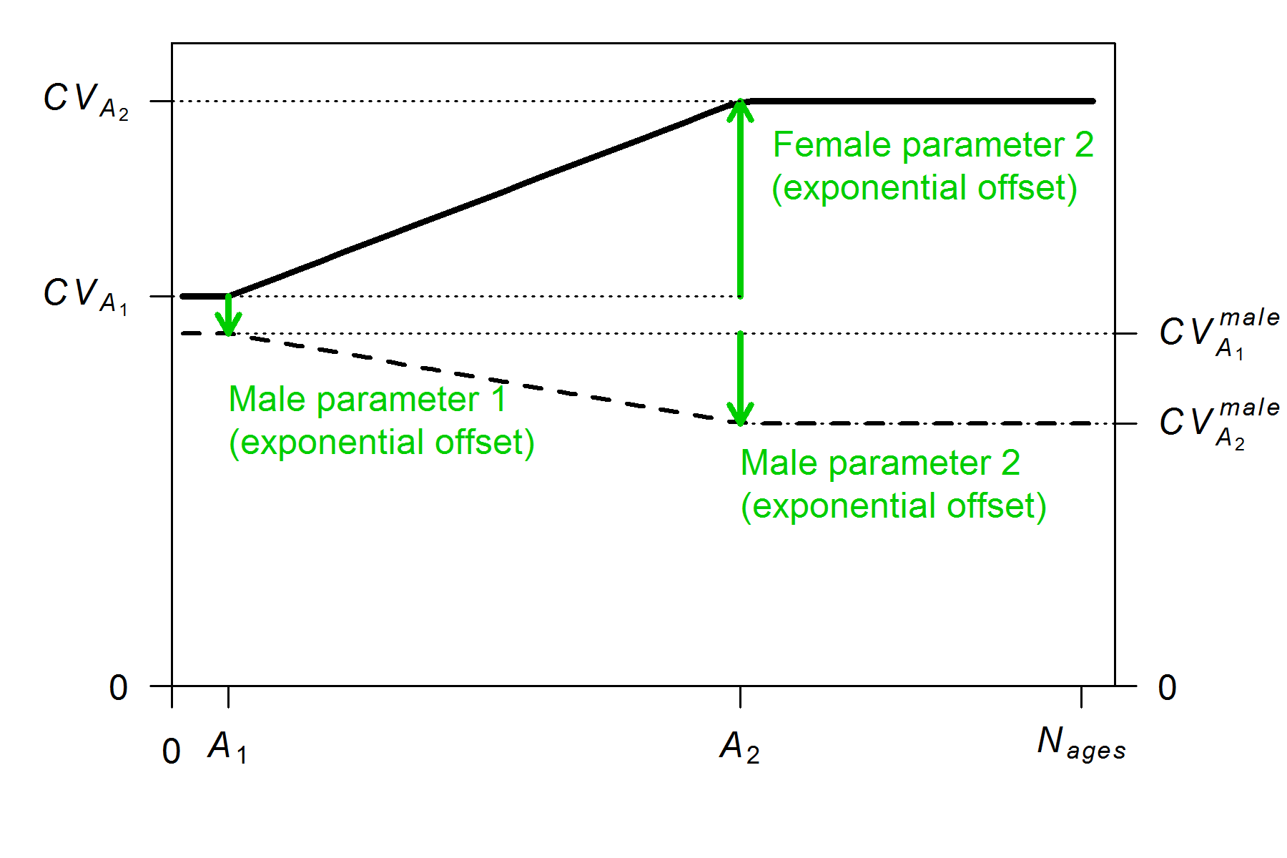
Parameterization of growth: length variability
Offset options for variability:
#_parameter_offset_approach (1=none, 2= M, G, CV_G as offset from female-GP1, 3=like SS2 V1.x)
source model: growth_illustration_offset3

Slide 14
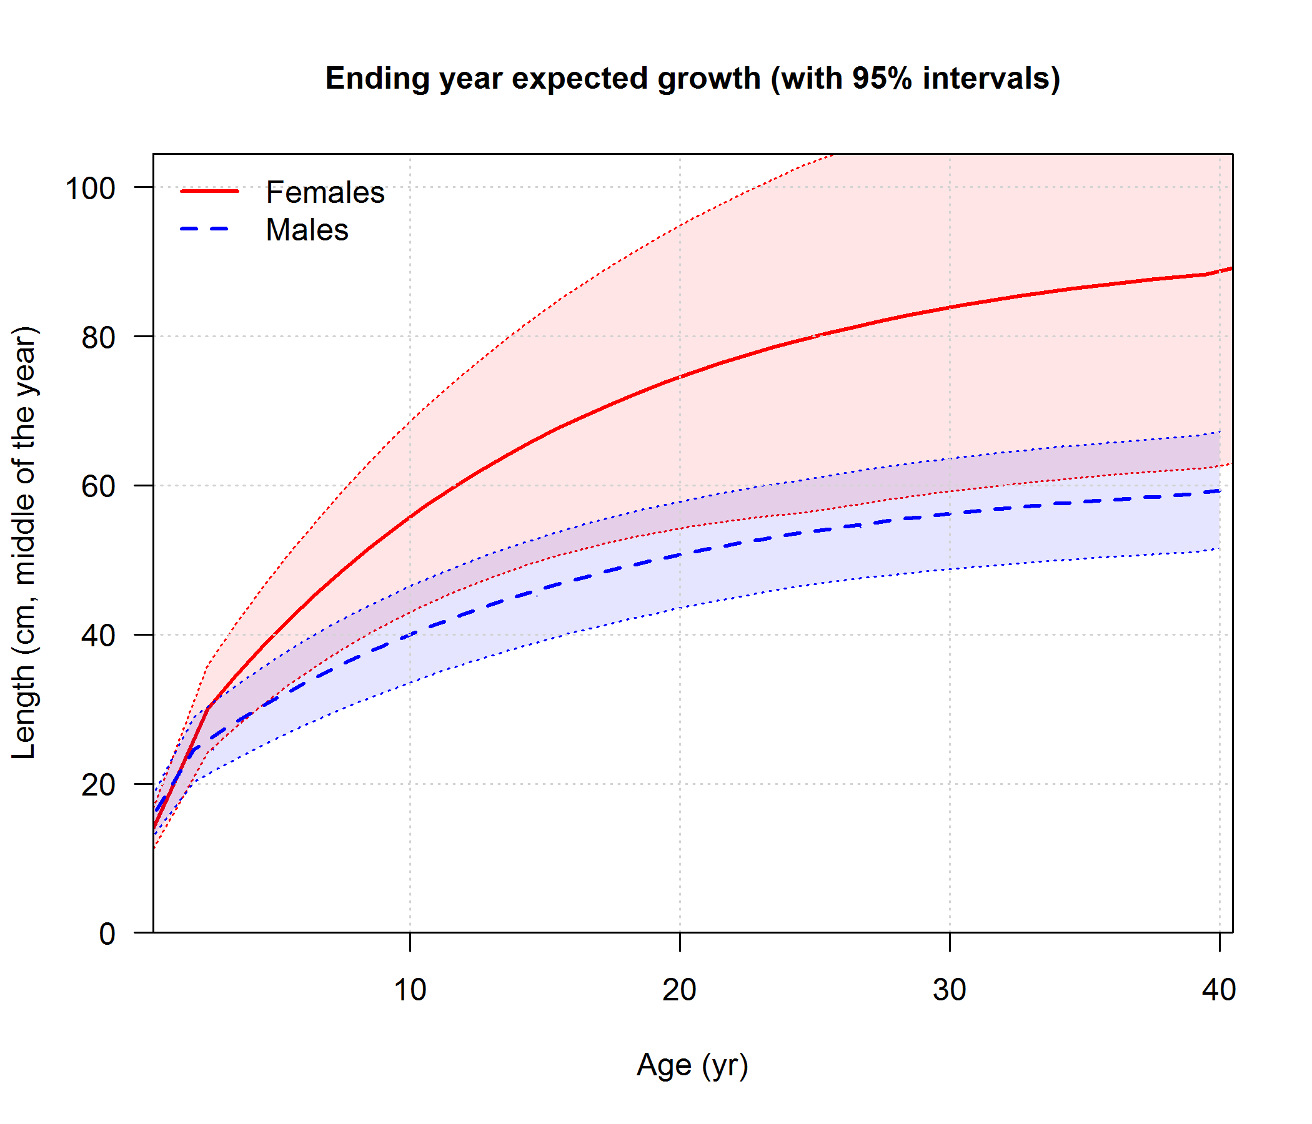
Parameterization of growth: summary
source model: growth_illustration_offset2

Slide 15
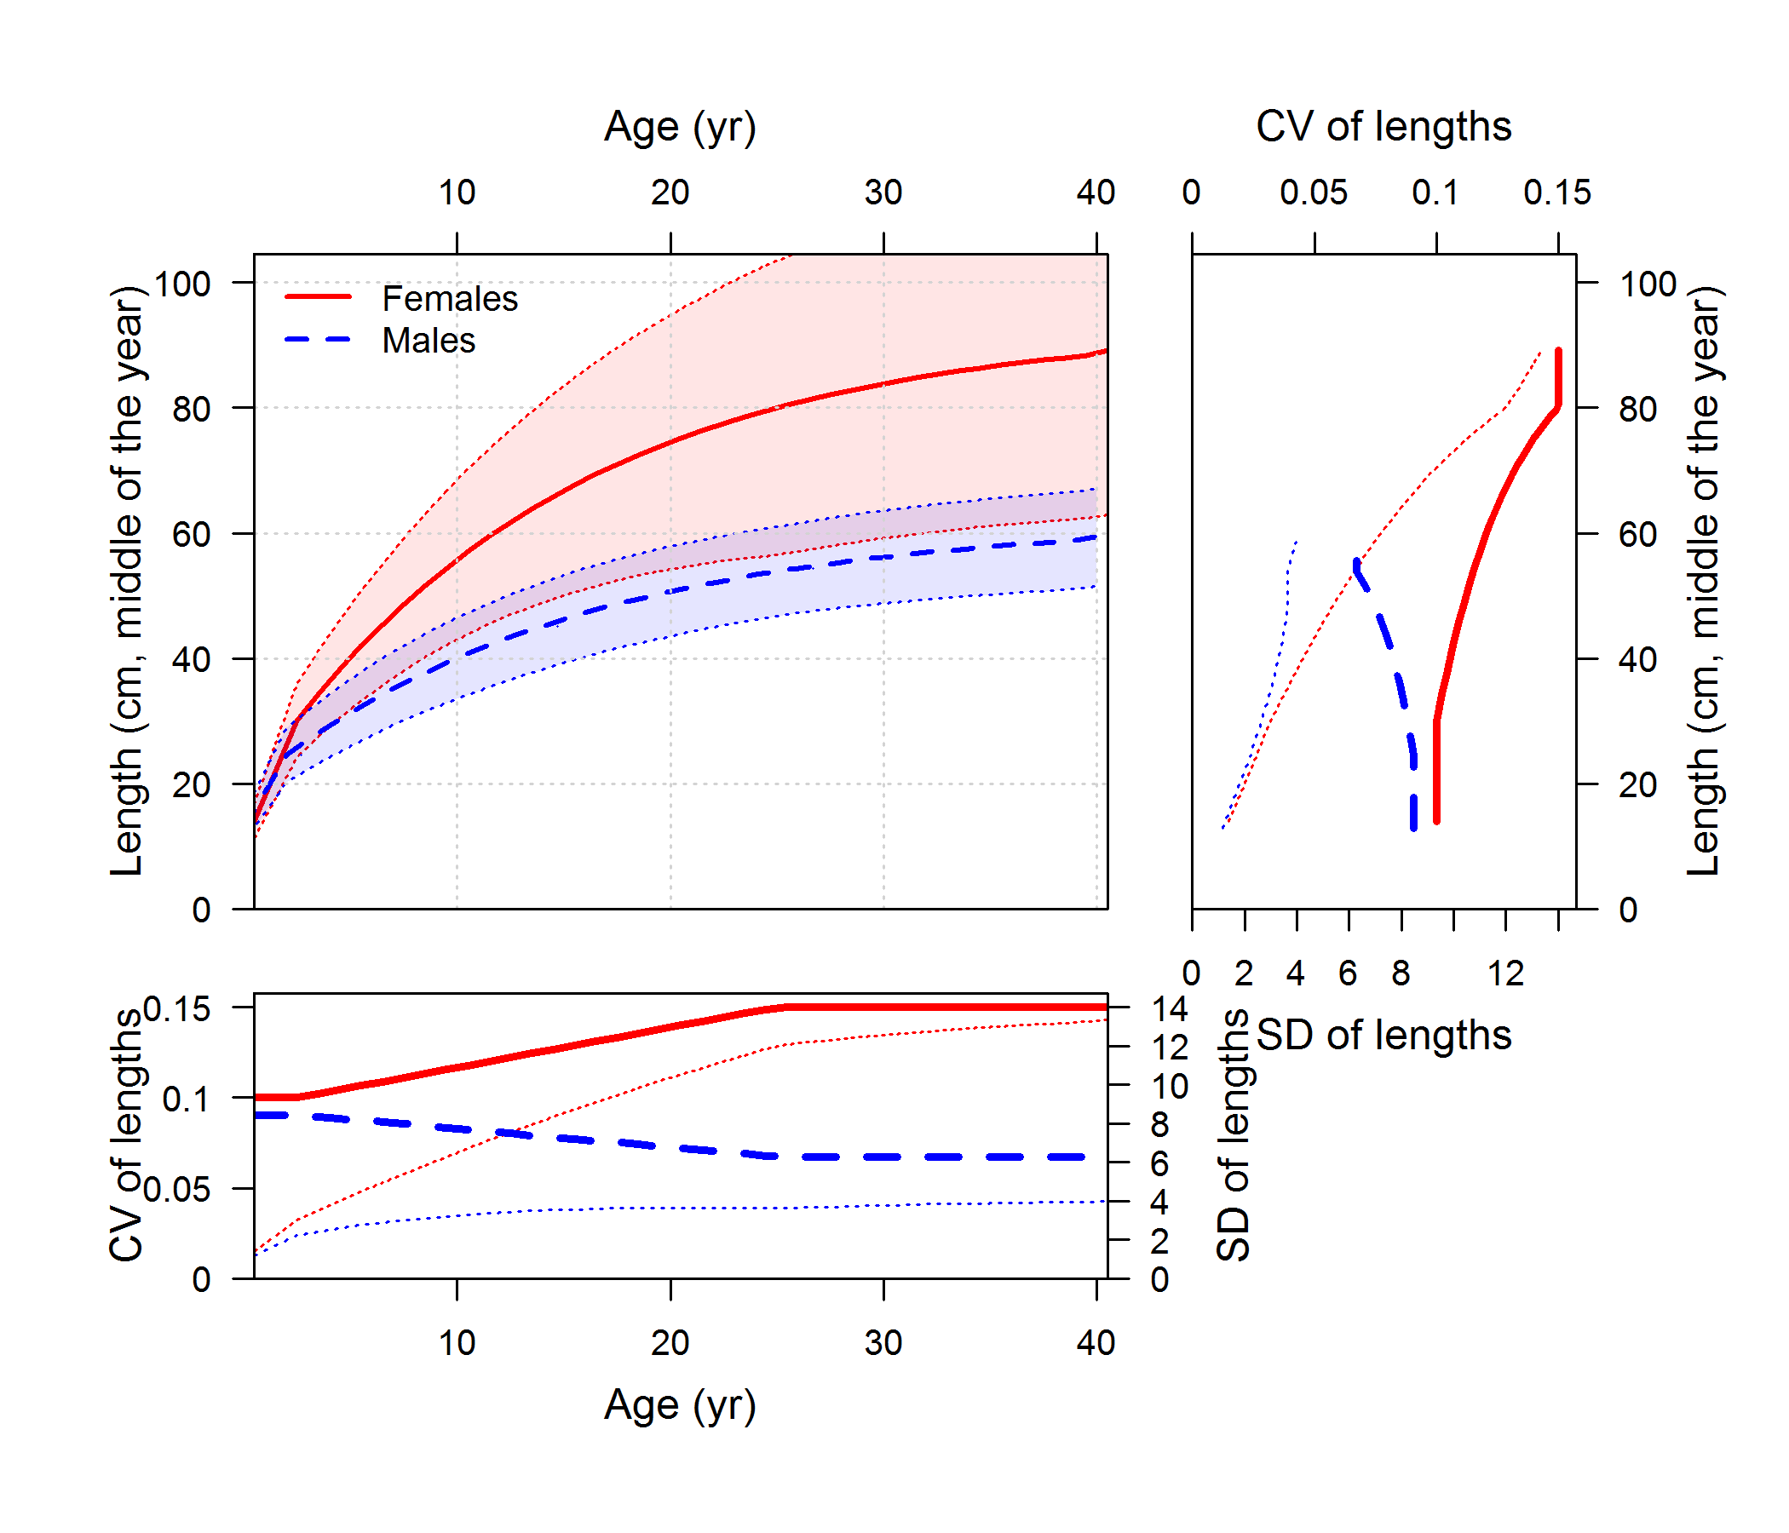
Parameterization of growth: summary
source model: growth_illustration_offset2

Slide 16
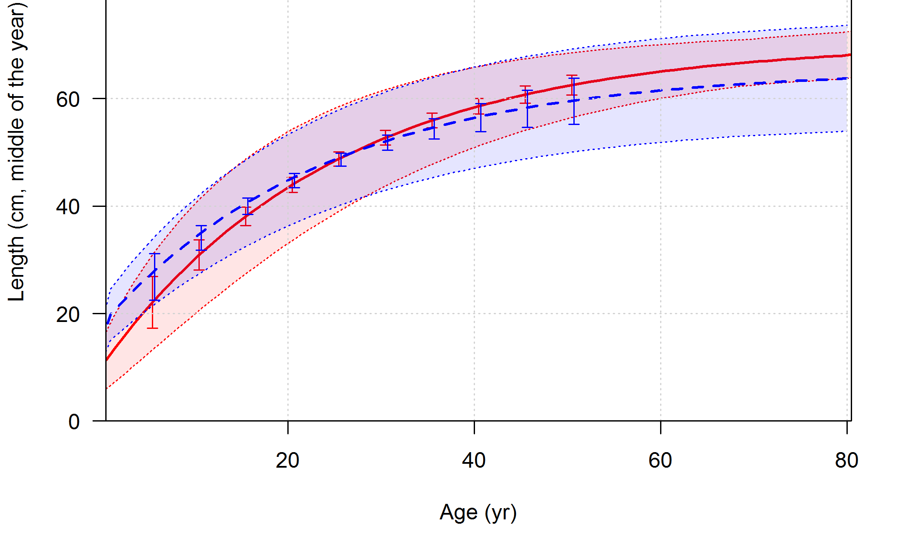
Parameterization of growth: uncertainty
1 # (0/1) read specs for more stddev reporting
1 1 -1 2 # selex type (flt), len=1/age=2, year, N selex bins (4 vals)
1 10 # Growth pattern, N growth ages (2 values)
1 -1 2 # NatAge_area(-1 for all), NatAge_yr, N Natages (3 values)
-1 1 # vector with selex std bin picks
5 10 15 20 25 30 35 40 45 50 # vector with growth std bin picks
-1 1 # vector with NatAge std bin picks
999 # end of control file
source model: rockfish_conditional_ages

Slide 17
Quantities that depend on growth and how they are connected

Slide 18
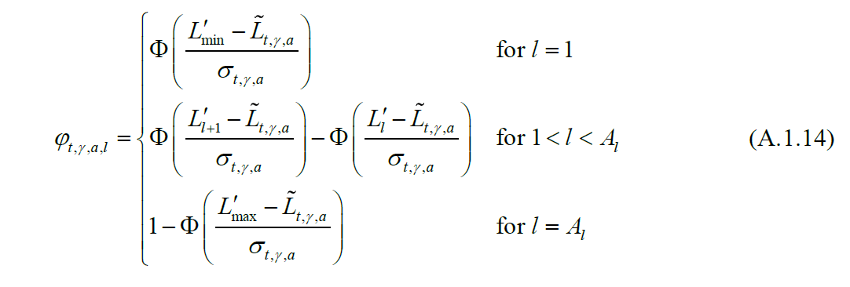
What depends on what
see Methot and Wetzel 2013 tech doc for details
Biological parameters
“Growth_Parameters”
$Growth_Parameters
Keyword in Report.sso
element of list in r4ss created by SS_output
Growth curve and CV
“Biology_at_age_in_endyr…”
$endgrowth
Matrix of length at age
“AGE_LENGTH_KEY”
$ALK
Apply selectivity at length
“AGE_LENGTH_KEY”
$ALK
source: Methot_Wetzel_2013_Appendix.pdf

Slide 19
What depends on what
see Methot and Wetzel 2013 tech doc for details
Biological parameters
“Growth_Parameters”
$Growth_Parameters
Keyword in Report.sso
element of R list created by SS_output in r4ss
Get comps by aggregating
over cohorts and then age or length or age conditioned on length
Growth curve and CV
“Biology_at_age_in_endyr…”
$endgrowth
Apply ageing error
“AGE_AGE_KEY”
$AAK
Matrix of length at age
“AGE_LENGTH_KEY”
$ALK
Apply selectivity at age or length
“LEN_SELEX” or “AGE_SELEX”
$sizeselex or $ageselex
Apply maturity at age or length
“BIOLOGY” or “Biology_at_age…”
$biology or $endgrowth
Get spawning biomass by aggregating over everything

Slide 20
Example models

Slide 21
Example models: overview
Models for illustrating parameterization (based on “simple”), (not to be used for estimation so use -nohess):
growth_illustration_offset2
growth_illustration_offset3
Model for illustrating empirical weight-at-age approach:
hake2014_simplified
Models for illustrating conditional and marginal age compositions:
rockfish_conditional_ages
rockfish_marginal_ages
small_pelagic_A1

Slide 22
Example models: data types
All length and age observations may be associated with (0) combined sexes, (1) females, (2) males, (3) females & males (but not combined)
Also associated with either (0) whole catch (discard + retained) (1) discarded catch (2) retained catch

Slide 23
Example models: data types
Length compositions
Age compositions
Can represent all observed fish (Lbin_lo = Lbin_hi = -1), or
Can be conditioned on a range of lengths
Meaning of Lbin_lo and Lbin_hi have based on input #_Lbin_method: 1=poplenbins; 2=datalenbins; 3=lengths
Lbin_lo = Lbin_hi references a single length bin
Mean length- or weight-at-age data
Based on observed age, which may included ageing error

Slide 24
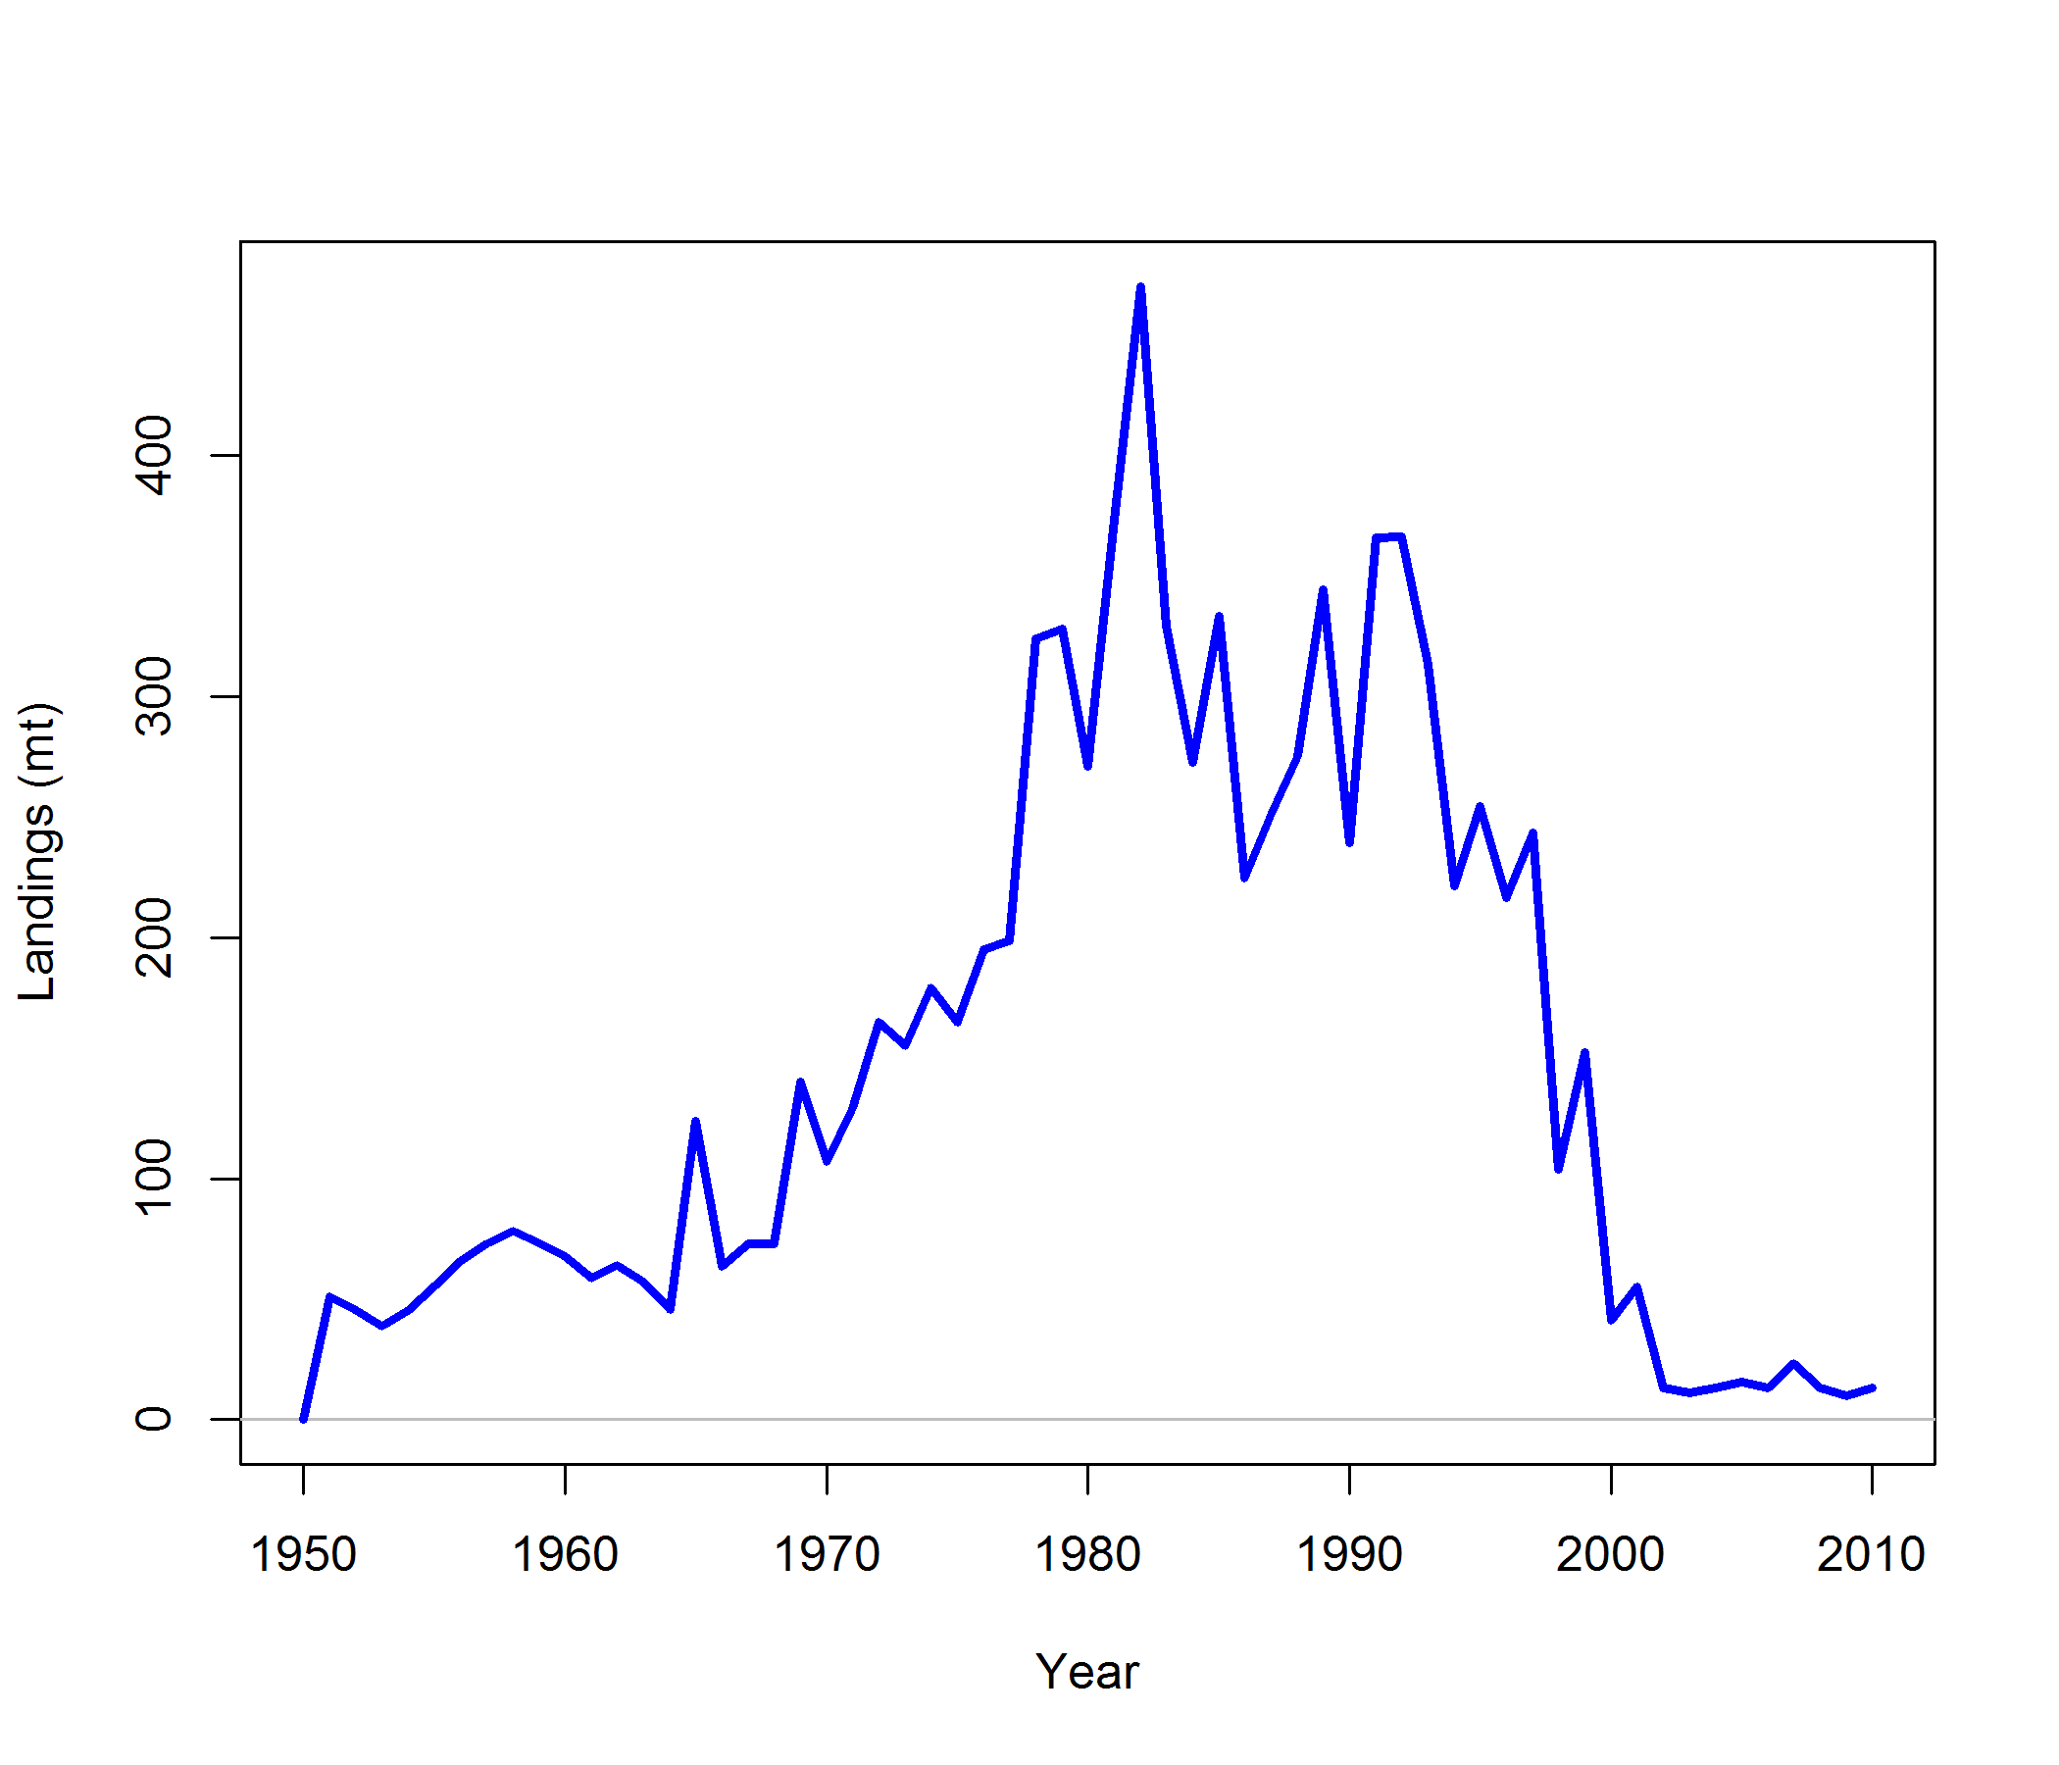
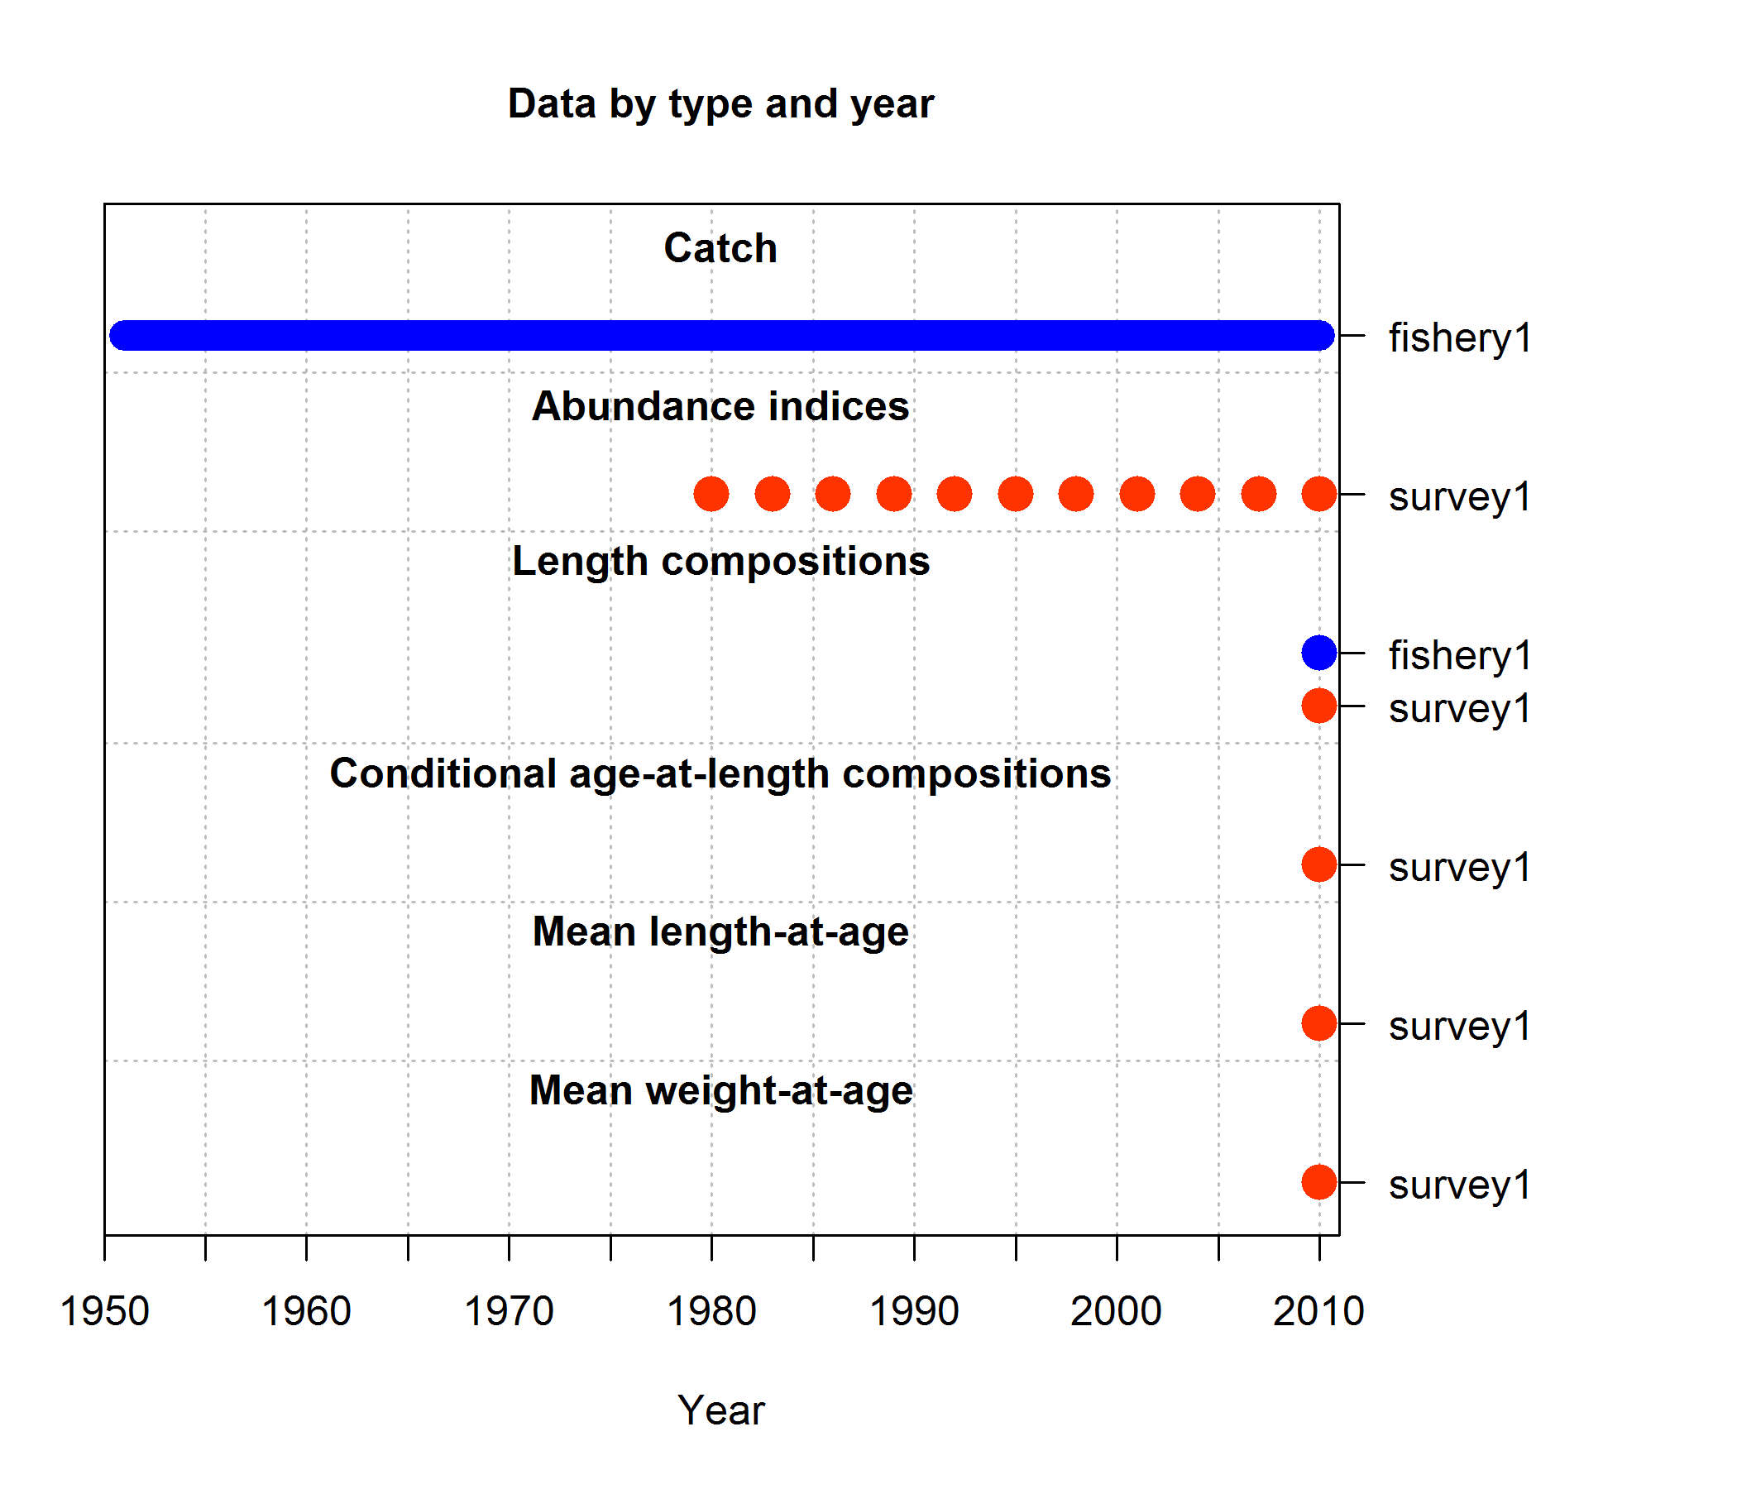
Example model: rockfish
Biology and catch history based on west coast assessment of yelloweye rockfish (also used in Taylor & Methot, 2013)
Simulated data:
triennial abundance index: 1980–2010, lengths and ages in 2010
24 Parameters estimated:
10 growth parameters (L₁, L₂, k, CV₁, CV₂ for both females and males)
10 selectivity parameters (5 param. double-normal x 2 fleets)
M (males & females), equilibrium recruitment log(R₀), steepness h,

Slide 25
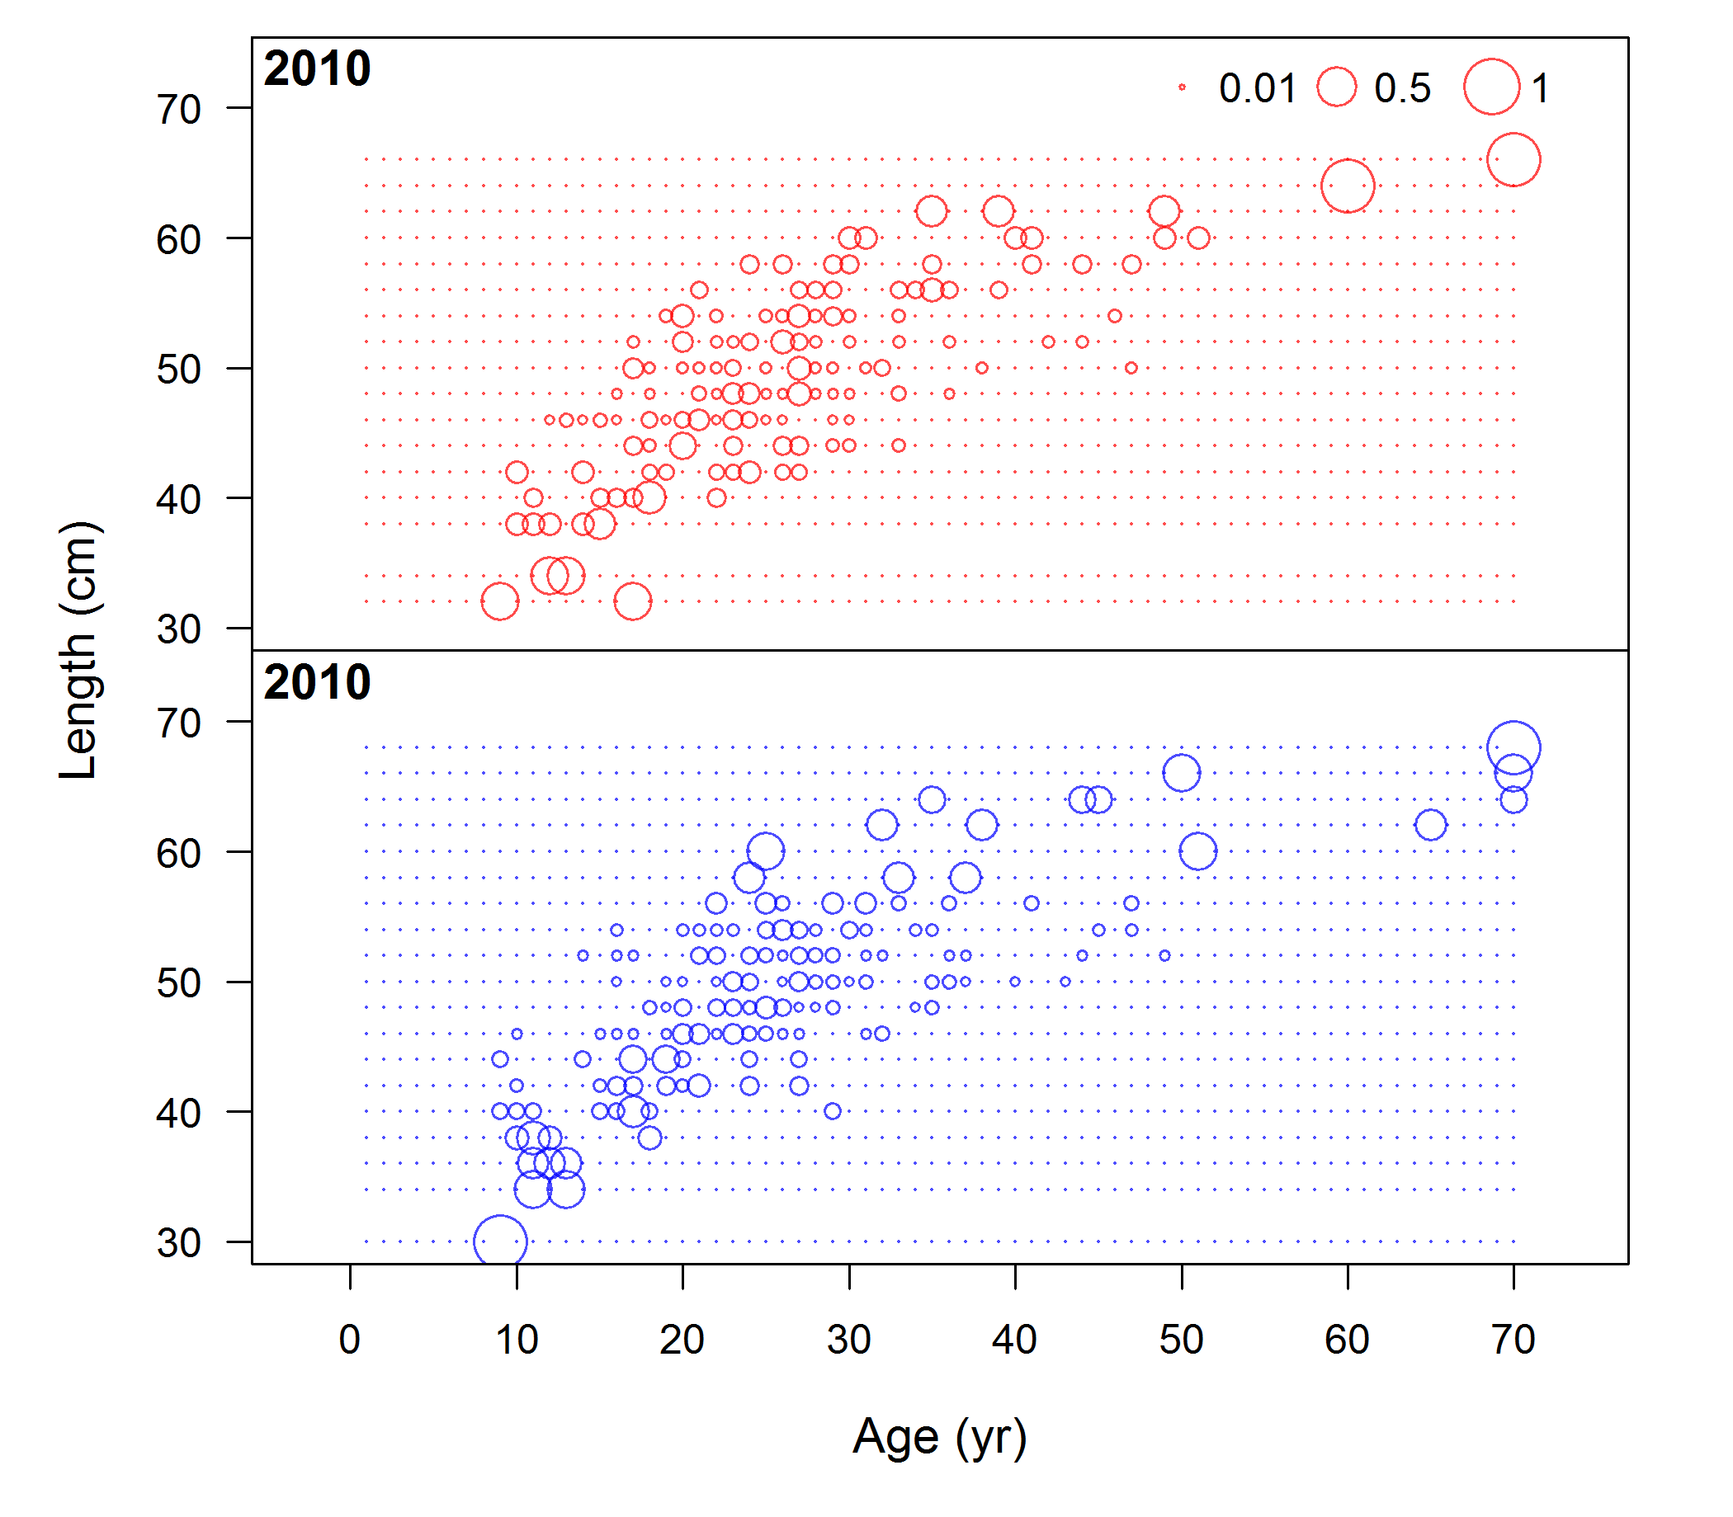
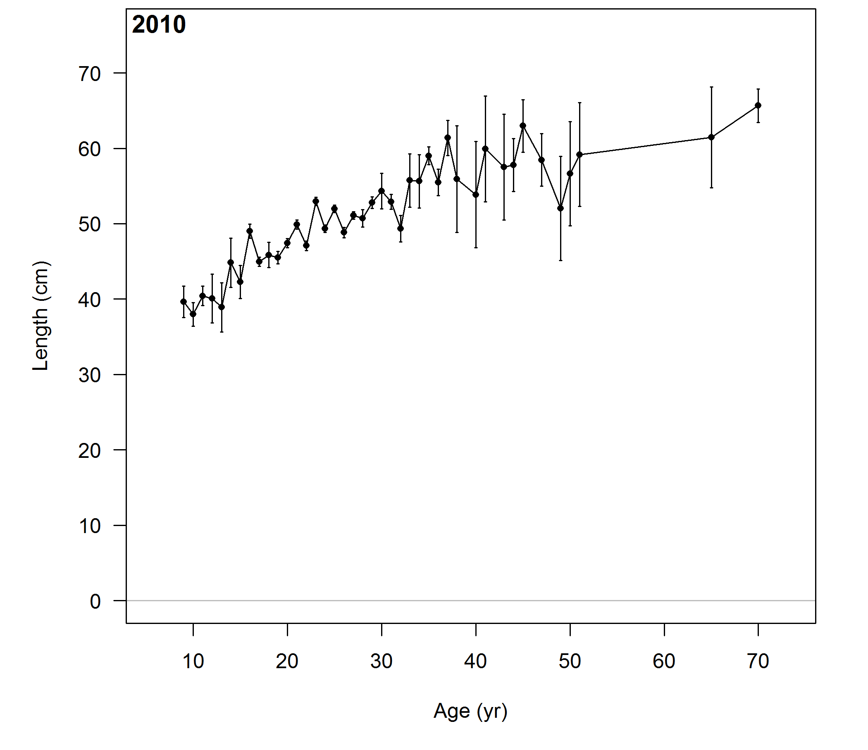
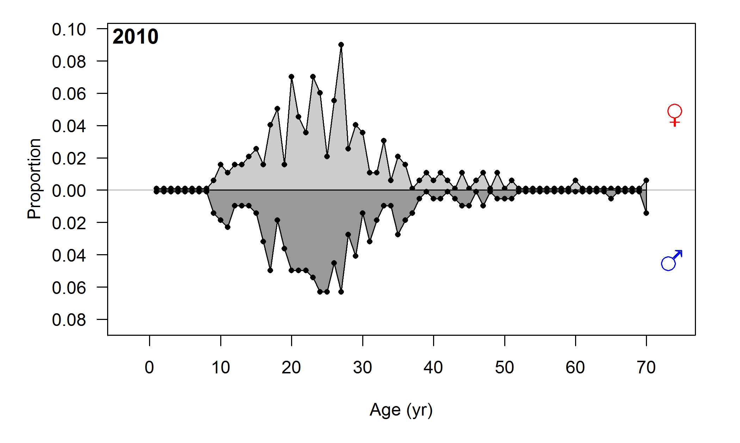
Example model: rockfish simulated data
mean length-at-age & marginal ages
conditional

Slide 26
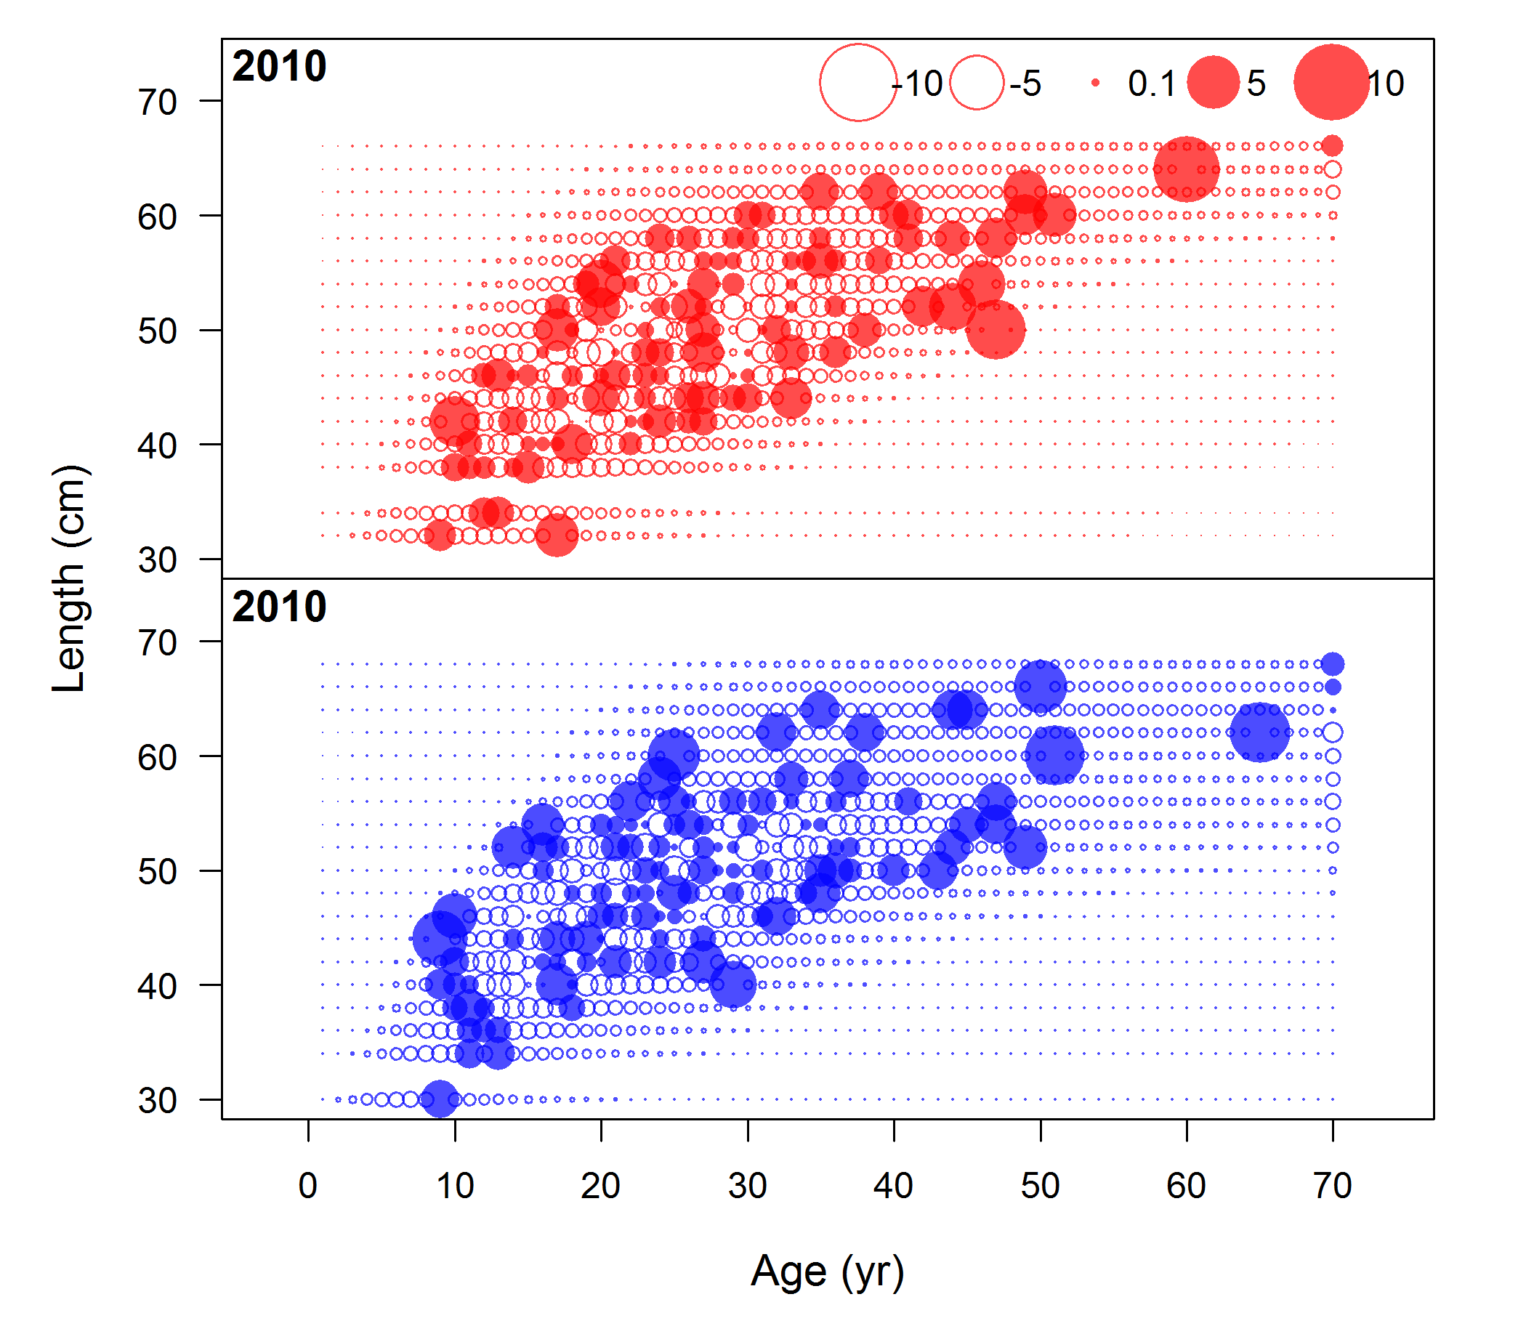
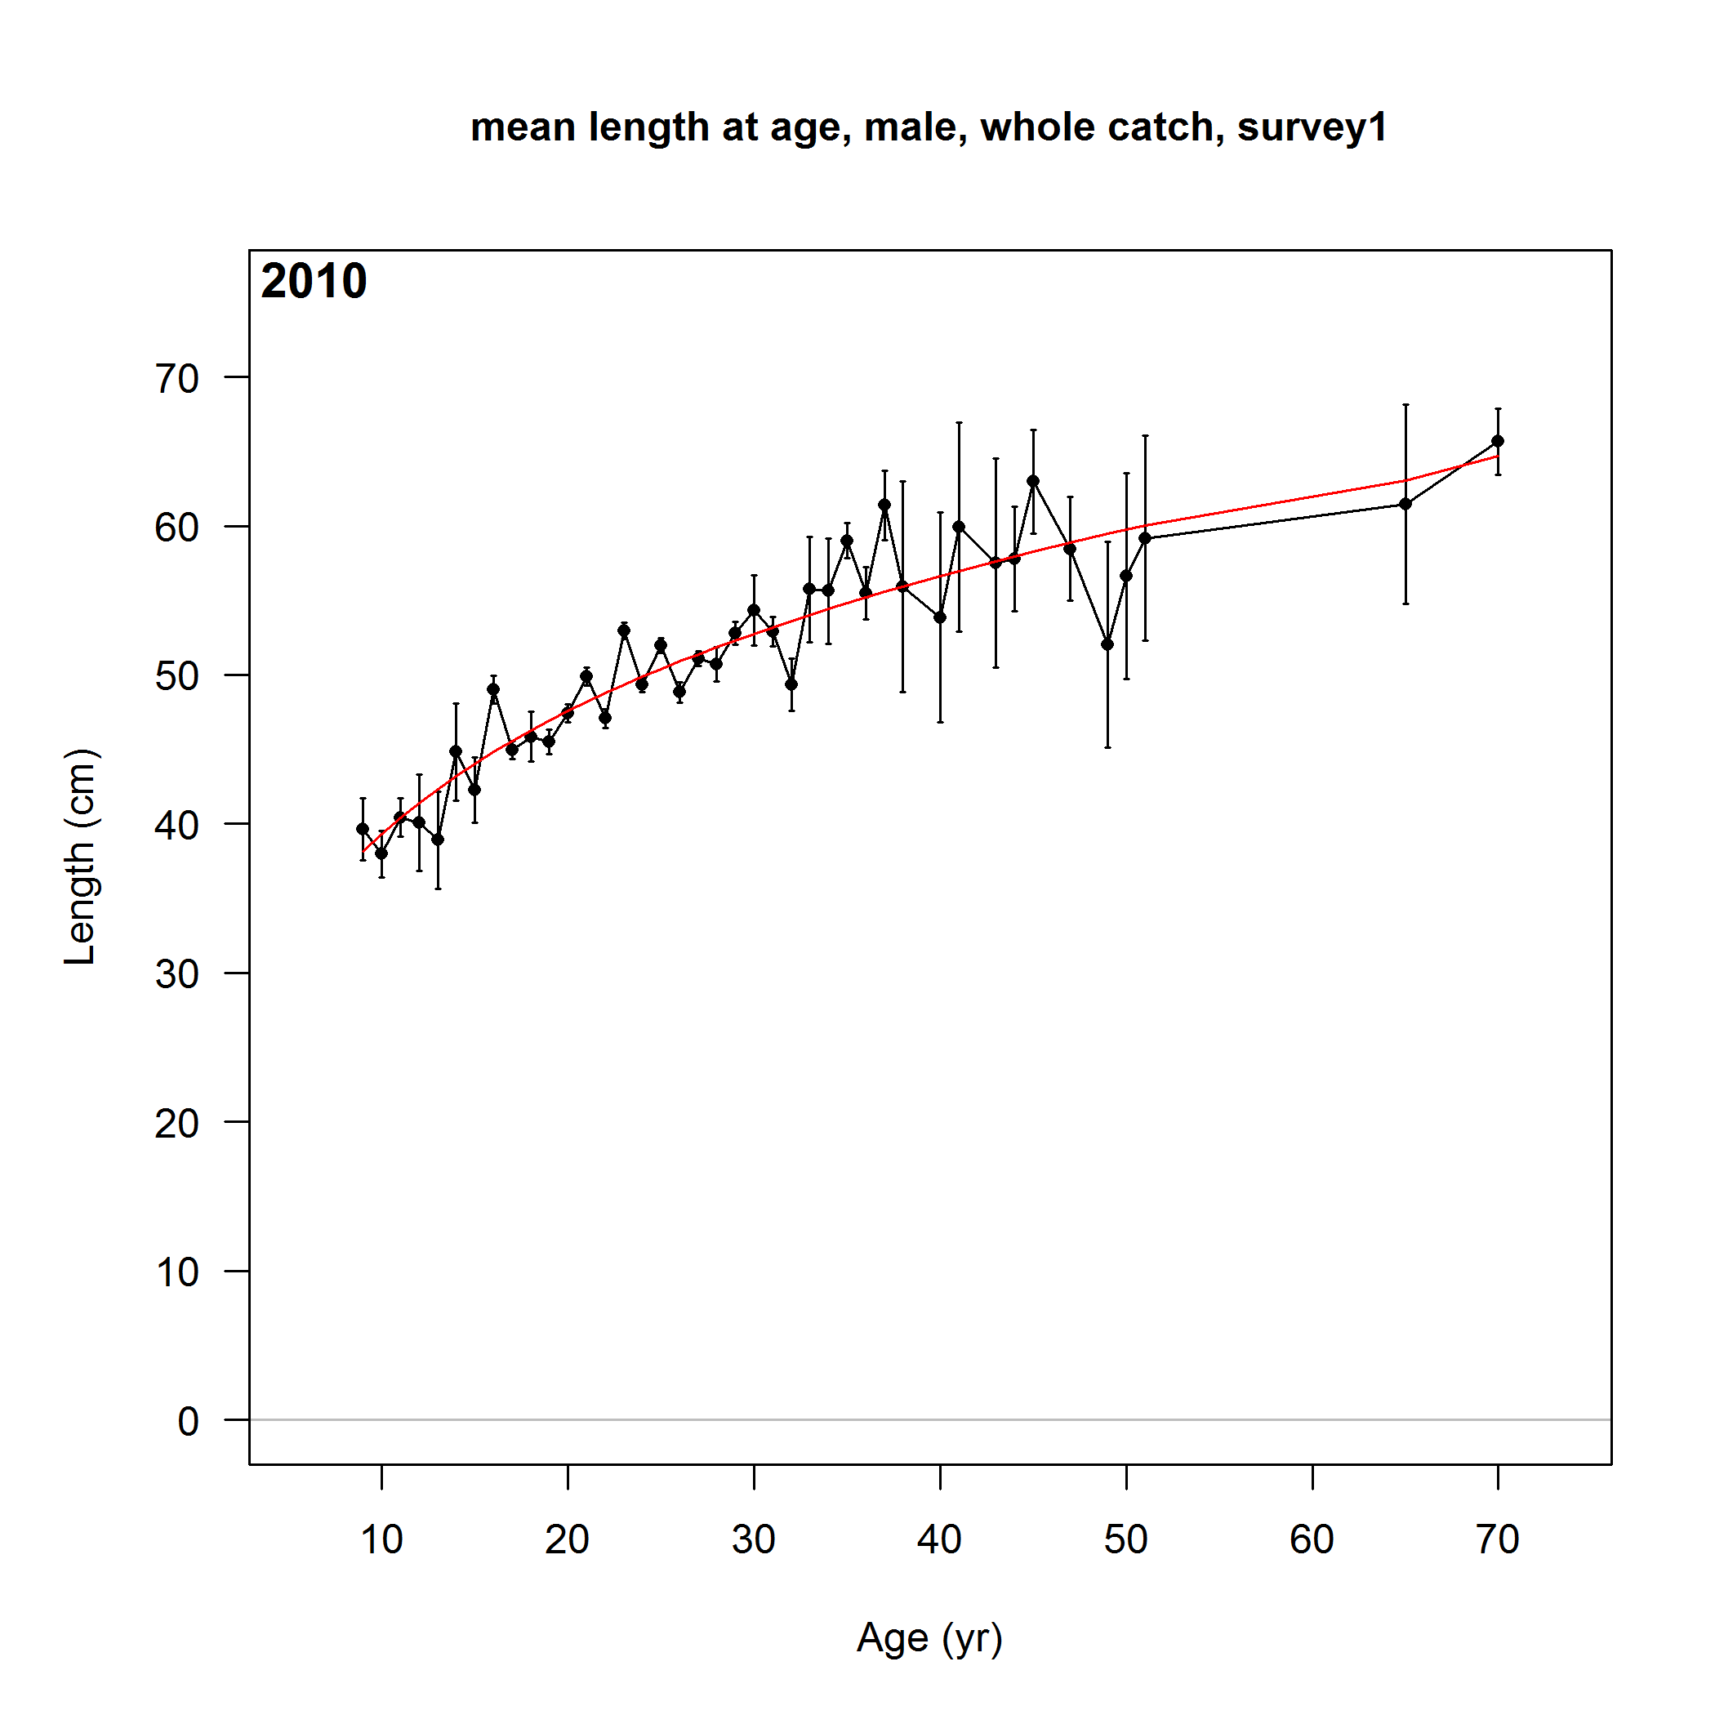
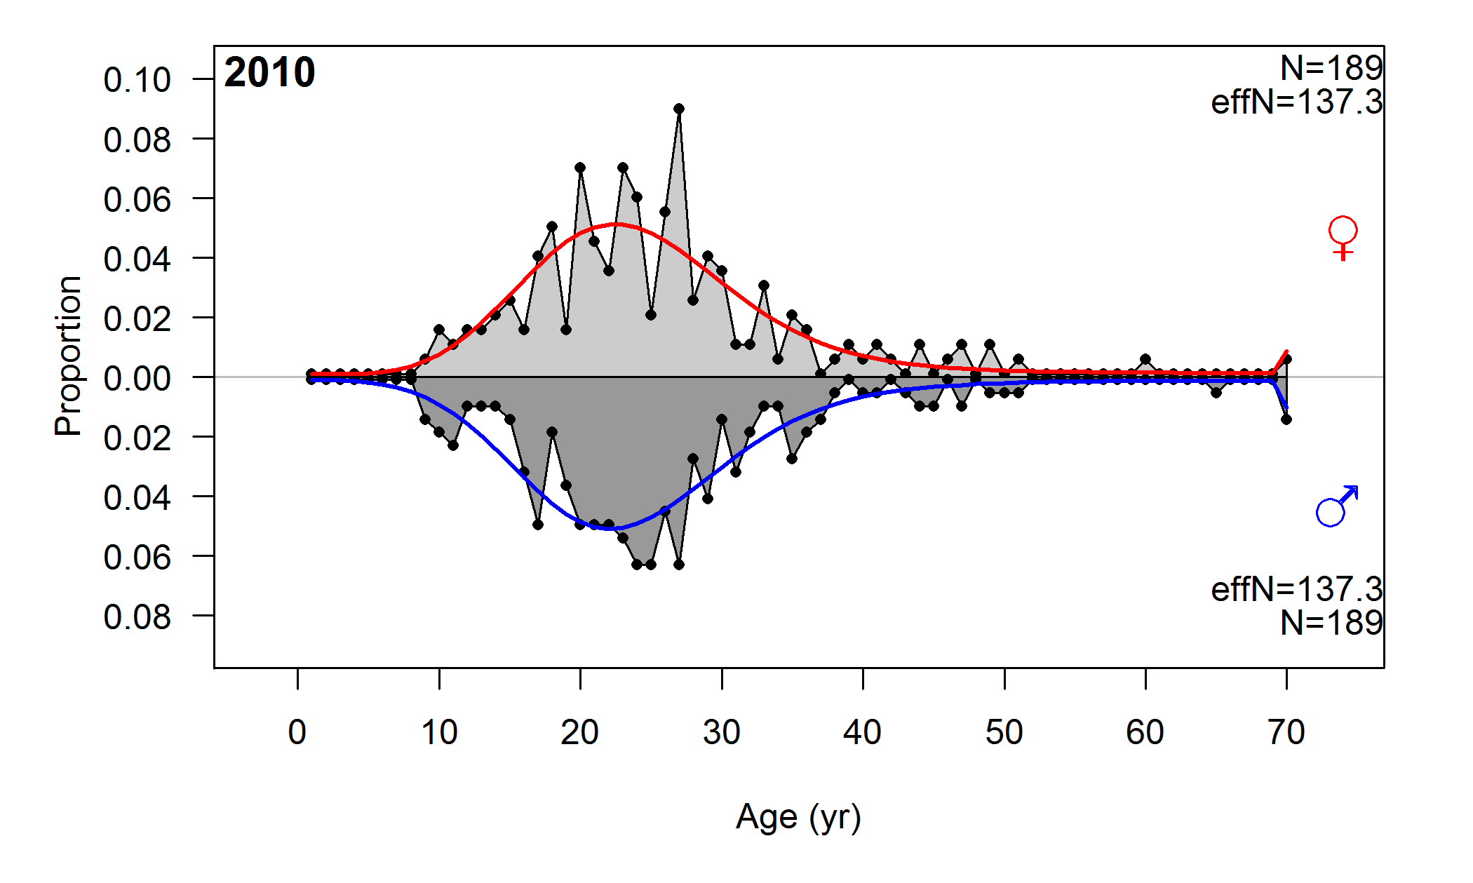
Example model: rockfish fits to data
mean length-at-age & marginal ages
conditional

Slide 27
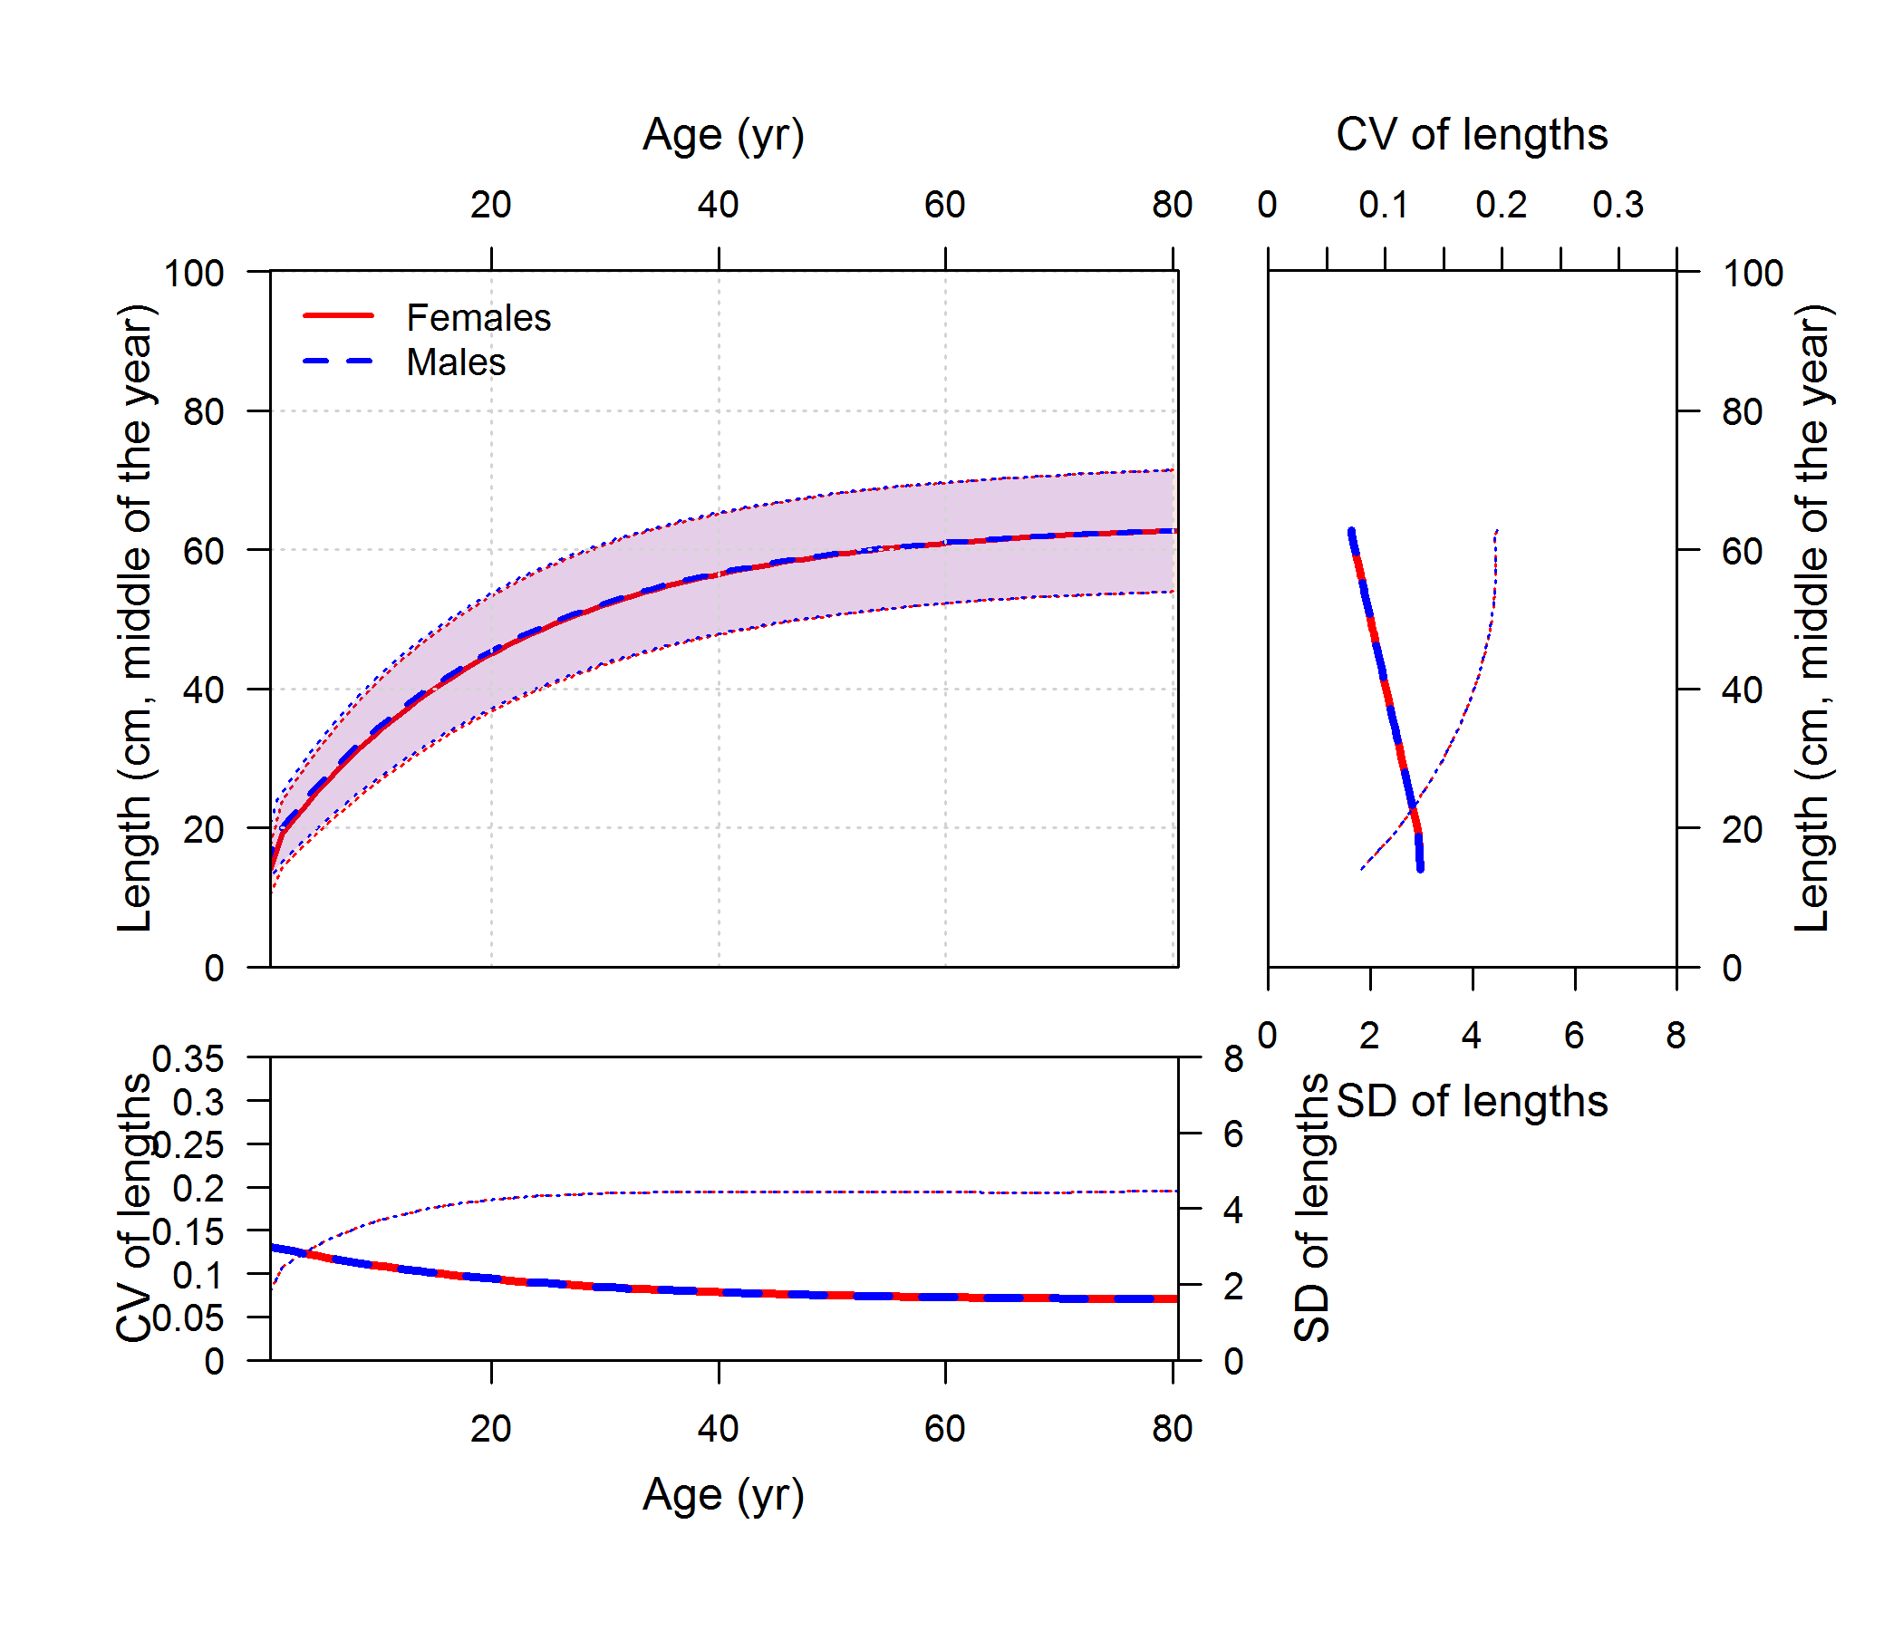
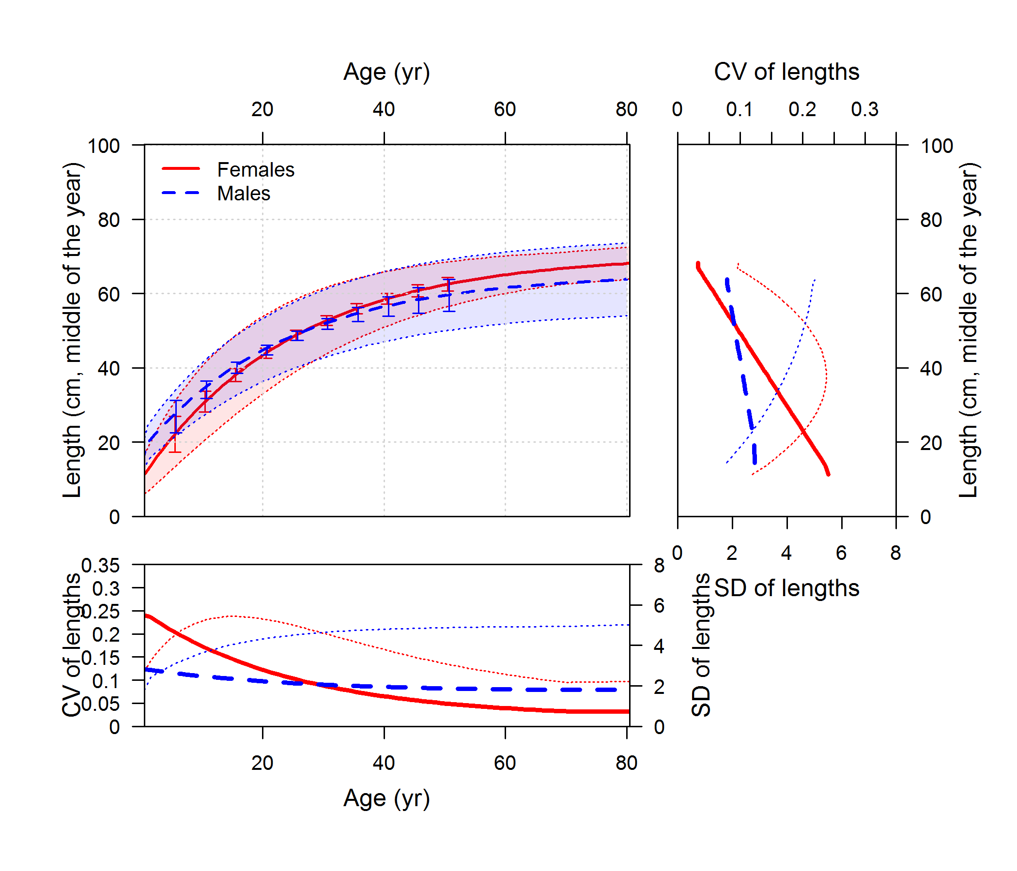

Example model: rockfish simulated growth
mean length-at-age & marginal ages
conditional
source model: extra_stuff/rockfish_simulation

Slide 28
Example model: rockfish estimated growth
mean length-at-age & marginal ages
conditional
Conclusion: similar fits, reasonable estimates of both growth curve and variability in growth
source model: rockfish_conditional_ages, rockfish_marginal_ages

Slide 29
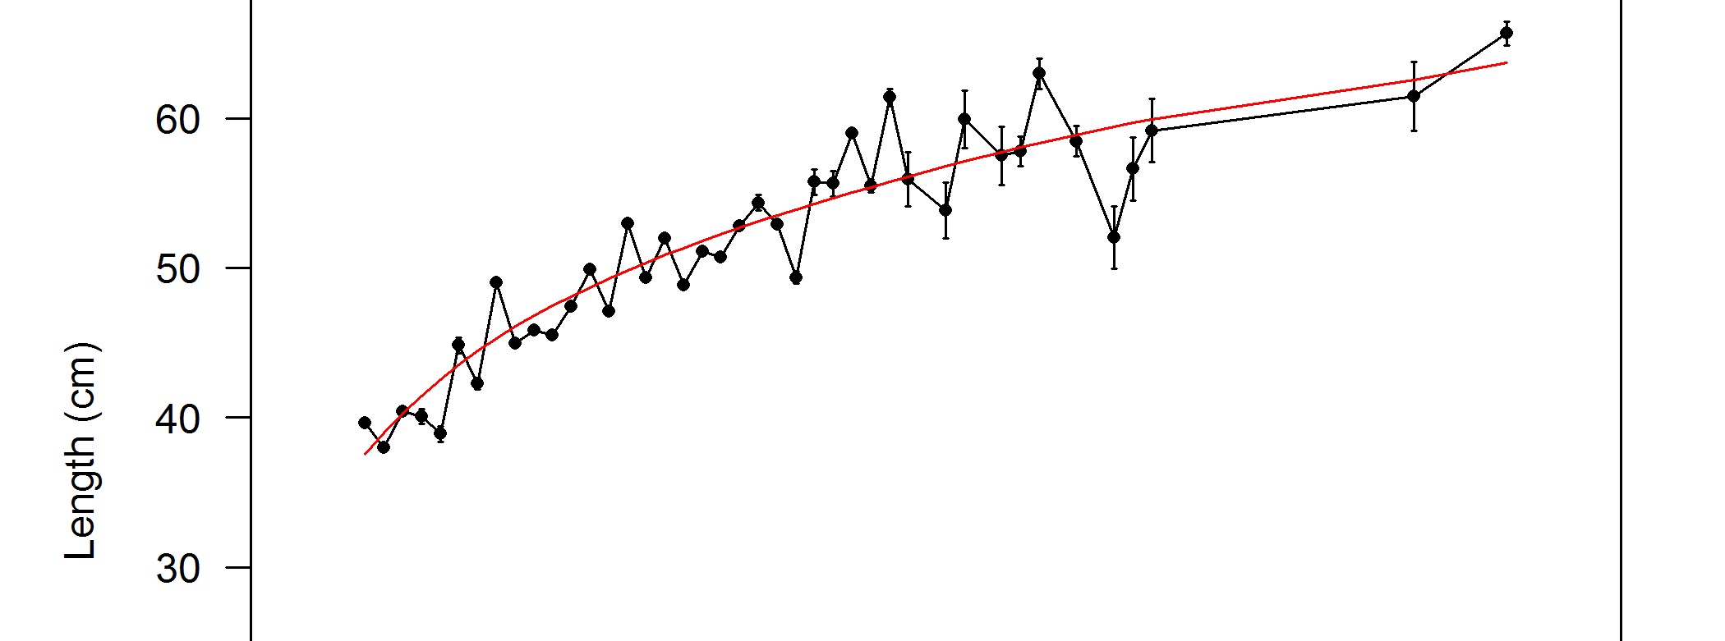
Example model: rockfish
Hypothesis:
Variability in mean lengths provides information about variability among fish
Test:
Multiply sample sizes by 10 and run models again
true sample size
N×10 sample size

Slide 30
Example model: rockfish simulated growth
mean length-at-age & marginal ages
conditional
source model: extra_stuff/rockfish_simulation

Slide 31
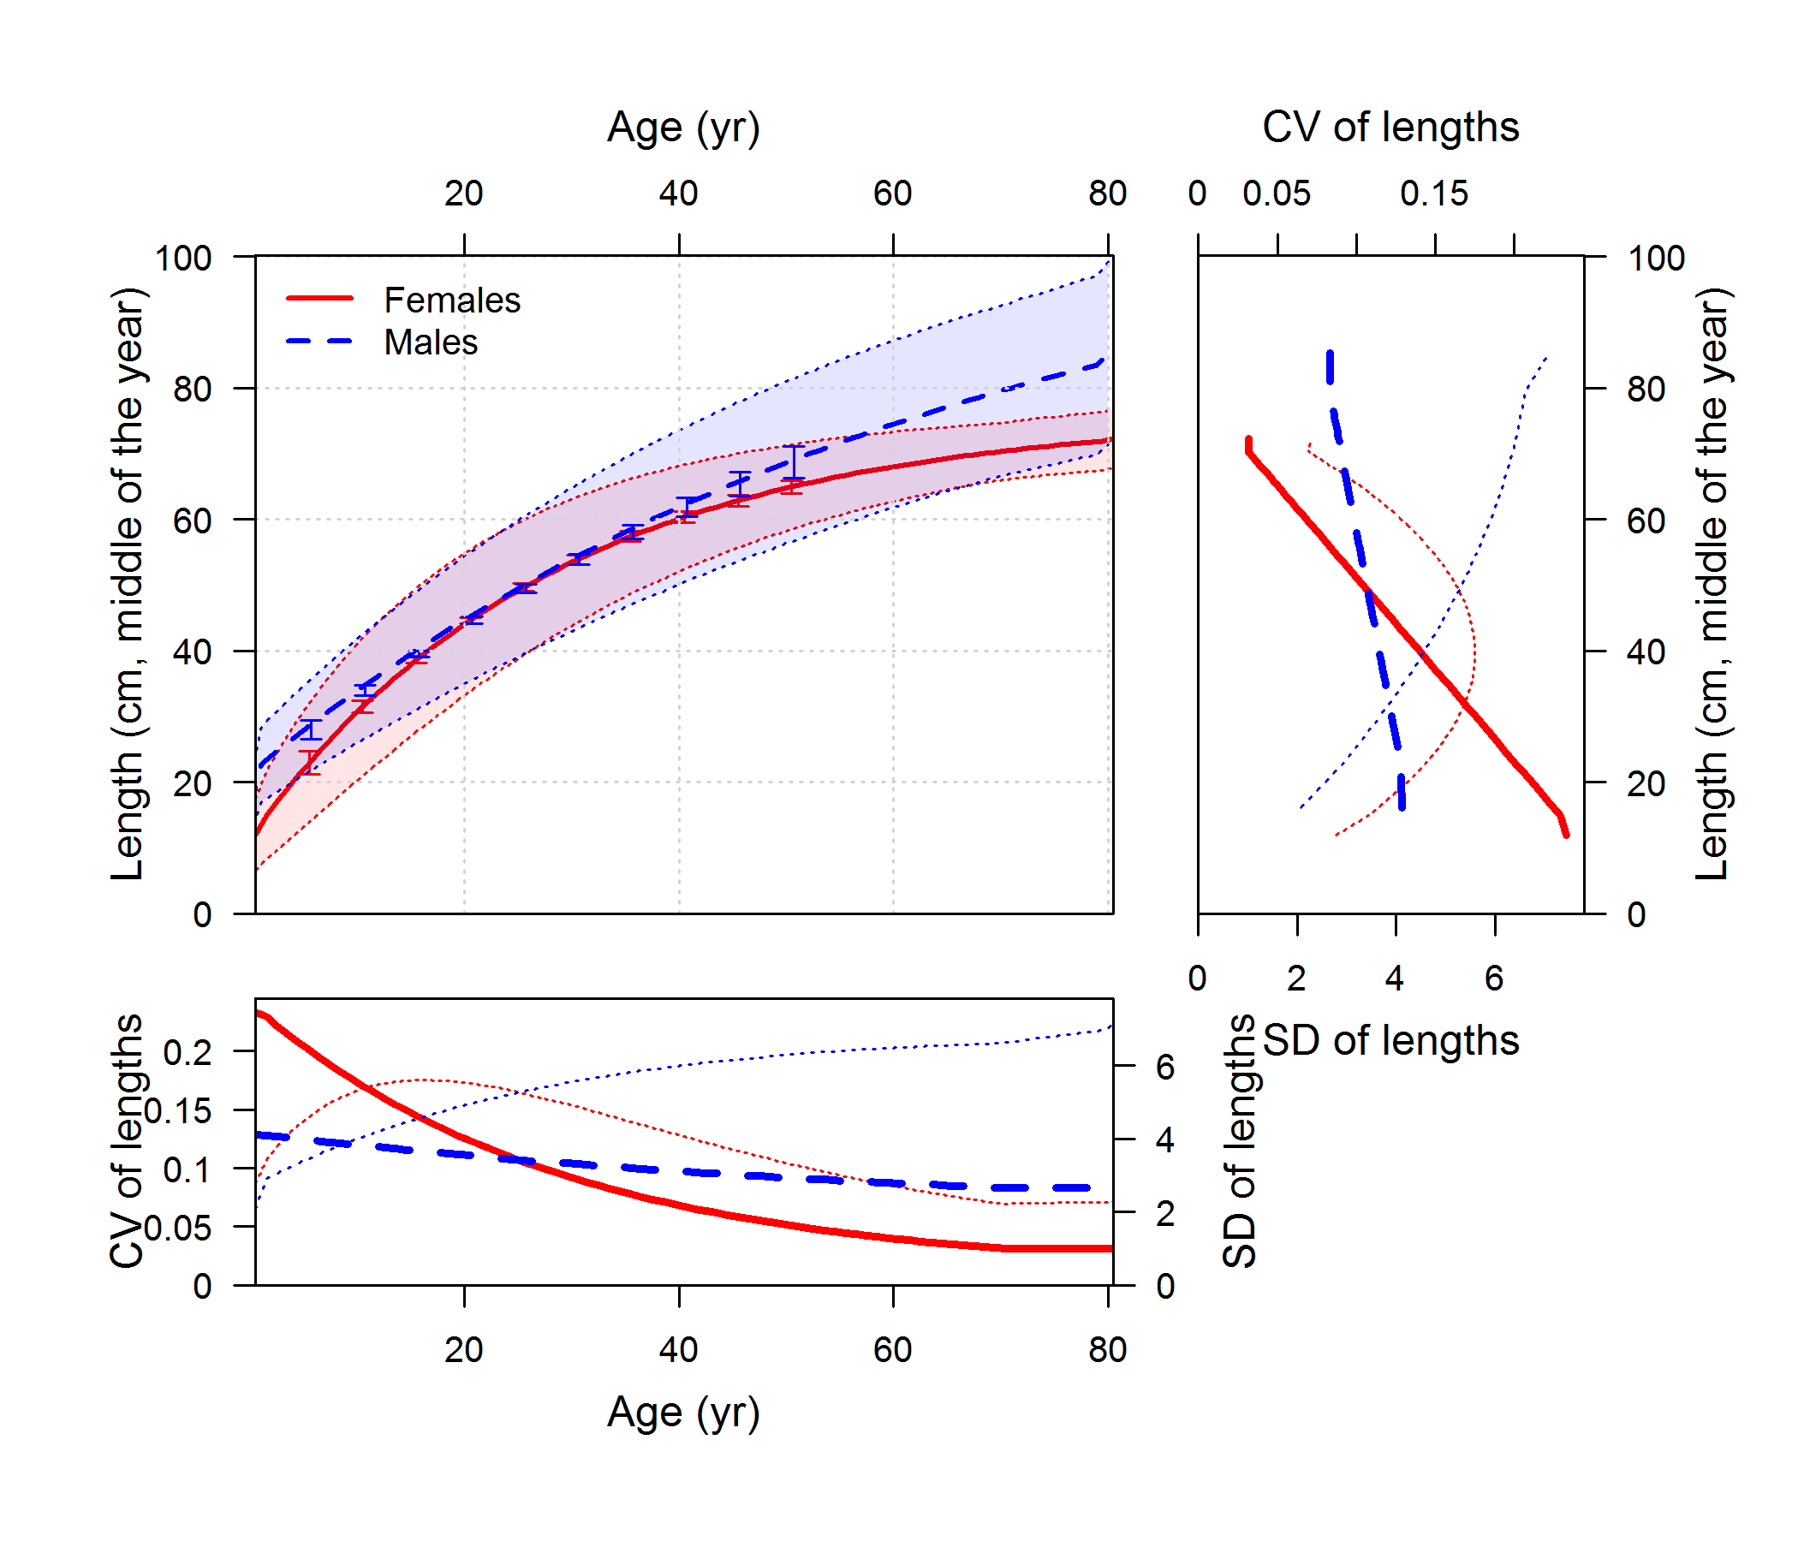
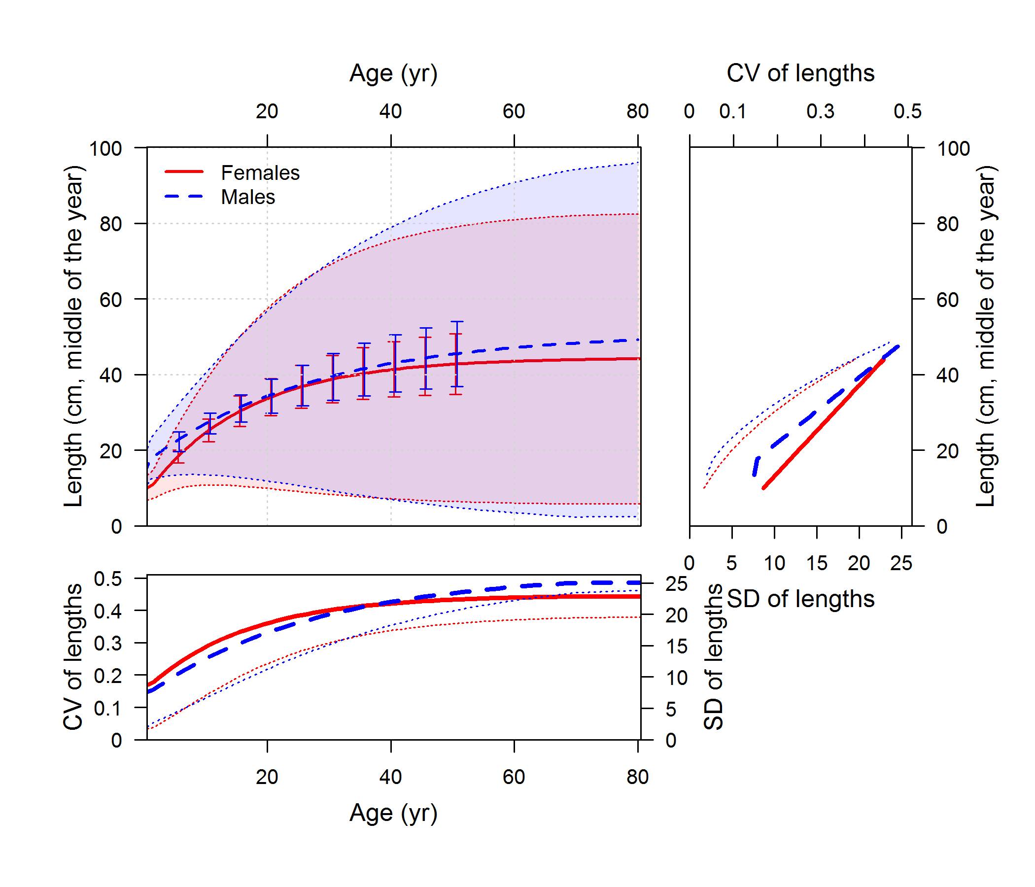
Example model: rockfish testing ages N×10
mean length-at-age & marginal ages
conditional
Conclusion: overdispersion in data caused bad estimate of variability in growth for marginal age model
source model: extra_stuff/rockfish_conditional_ages_highN, extra_stuff/rockfish_marginal_ages_highN

Slide 32
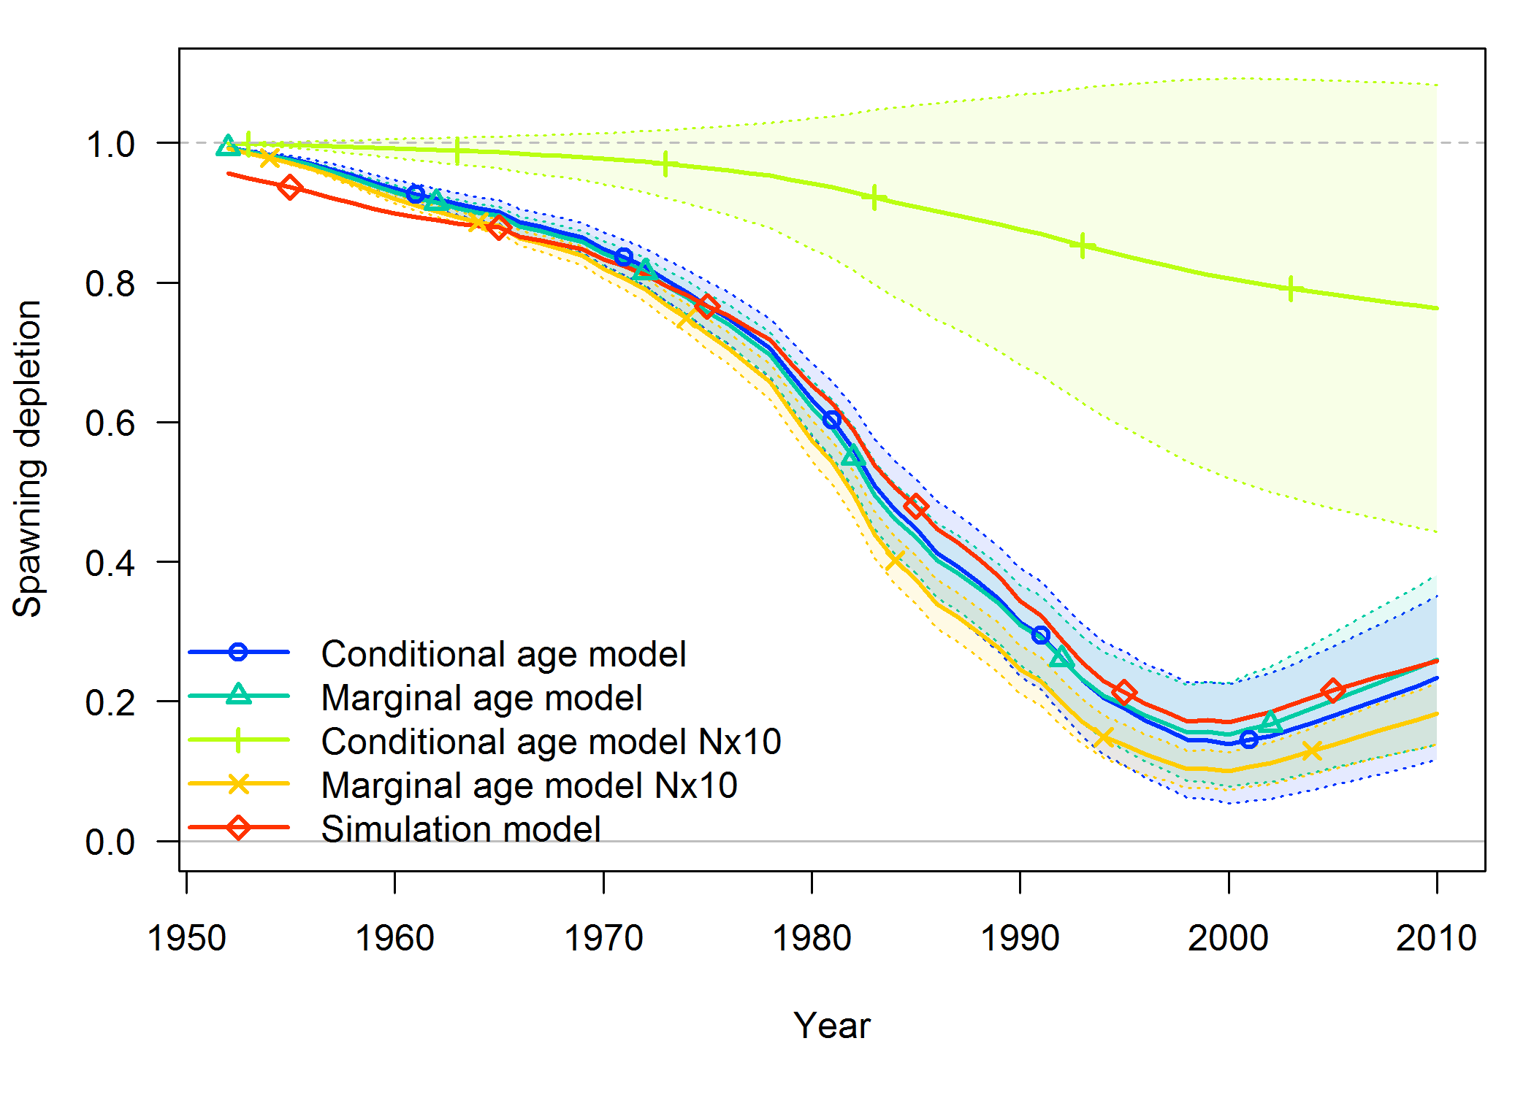
Example model: rockfish testing ages N×10
Ironic addendum: overdispersed data messed up stock status estimates for conditional model, not marginal model

Slide 33
Example model: rockfish testing ages N×10
Ironic addendum: overdispersed data messed up stock status estimates for conditional model, not marginal model

Slide 34
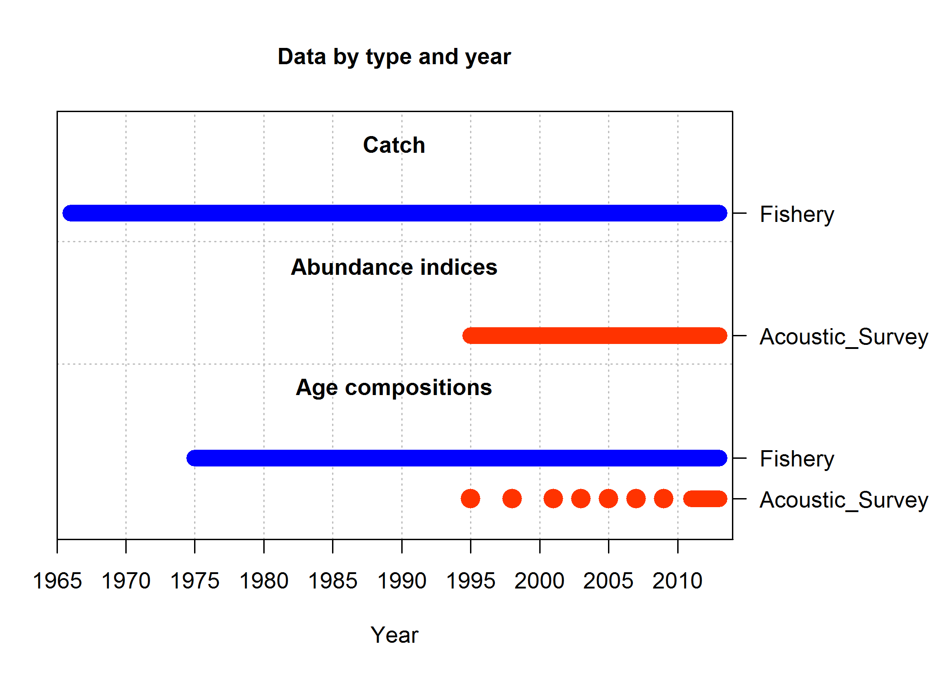
Example model: hake
Hake stock assessment for 2014 with 2 changes:
Cohort-specific ageing error removed
Time-varying non-parametric selectivity replaced with logistic
Data:
Age comps for many fishery years and fewer survey years
Index of abundance
Empirical weight-at-age matrix (not really data)
79 Parameters estimated:
0 growth parameters
4 selectivity parameters (2 param. logistic x 2 fleets)
71 recruitment deviations
M (sexes are combined), equilibrium recruitment log(R₀), steepness (h),
source model: hake2014_simplified

Slide 35
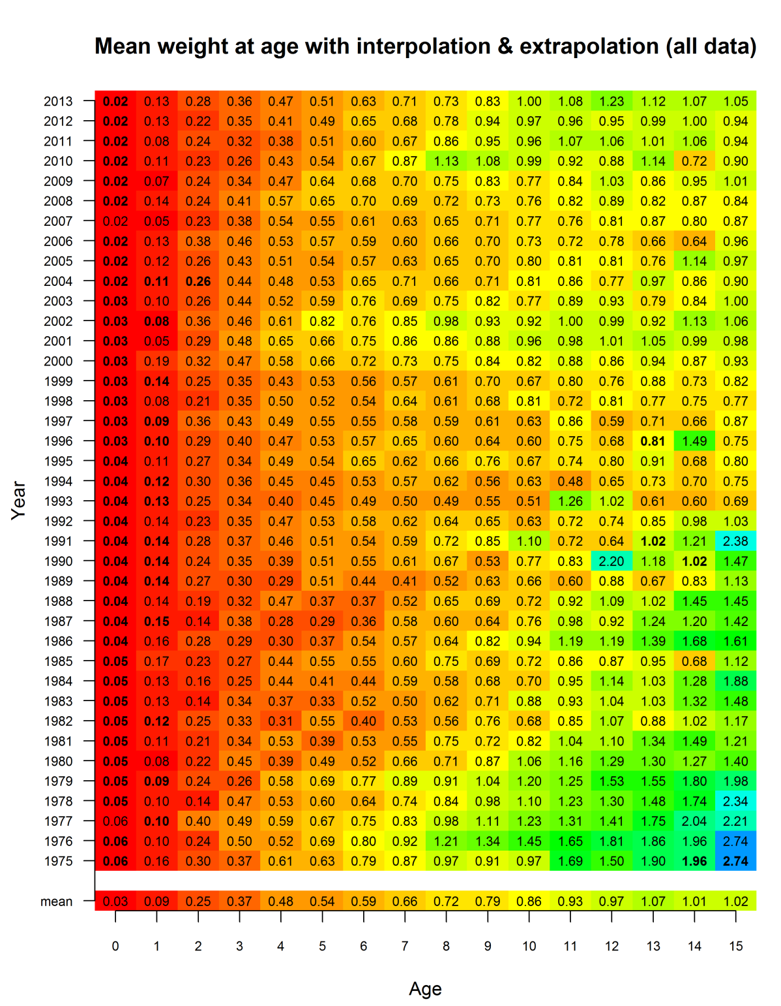
Example model: hake, weight at age
Matrix of weights
includes interpolations and extrapolations
early years assumed equal to mean
ages 15+ assumed constant
More exciting info 8am Friday morning
source model: hake2014_simplified

Slide 36
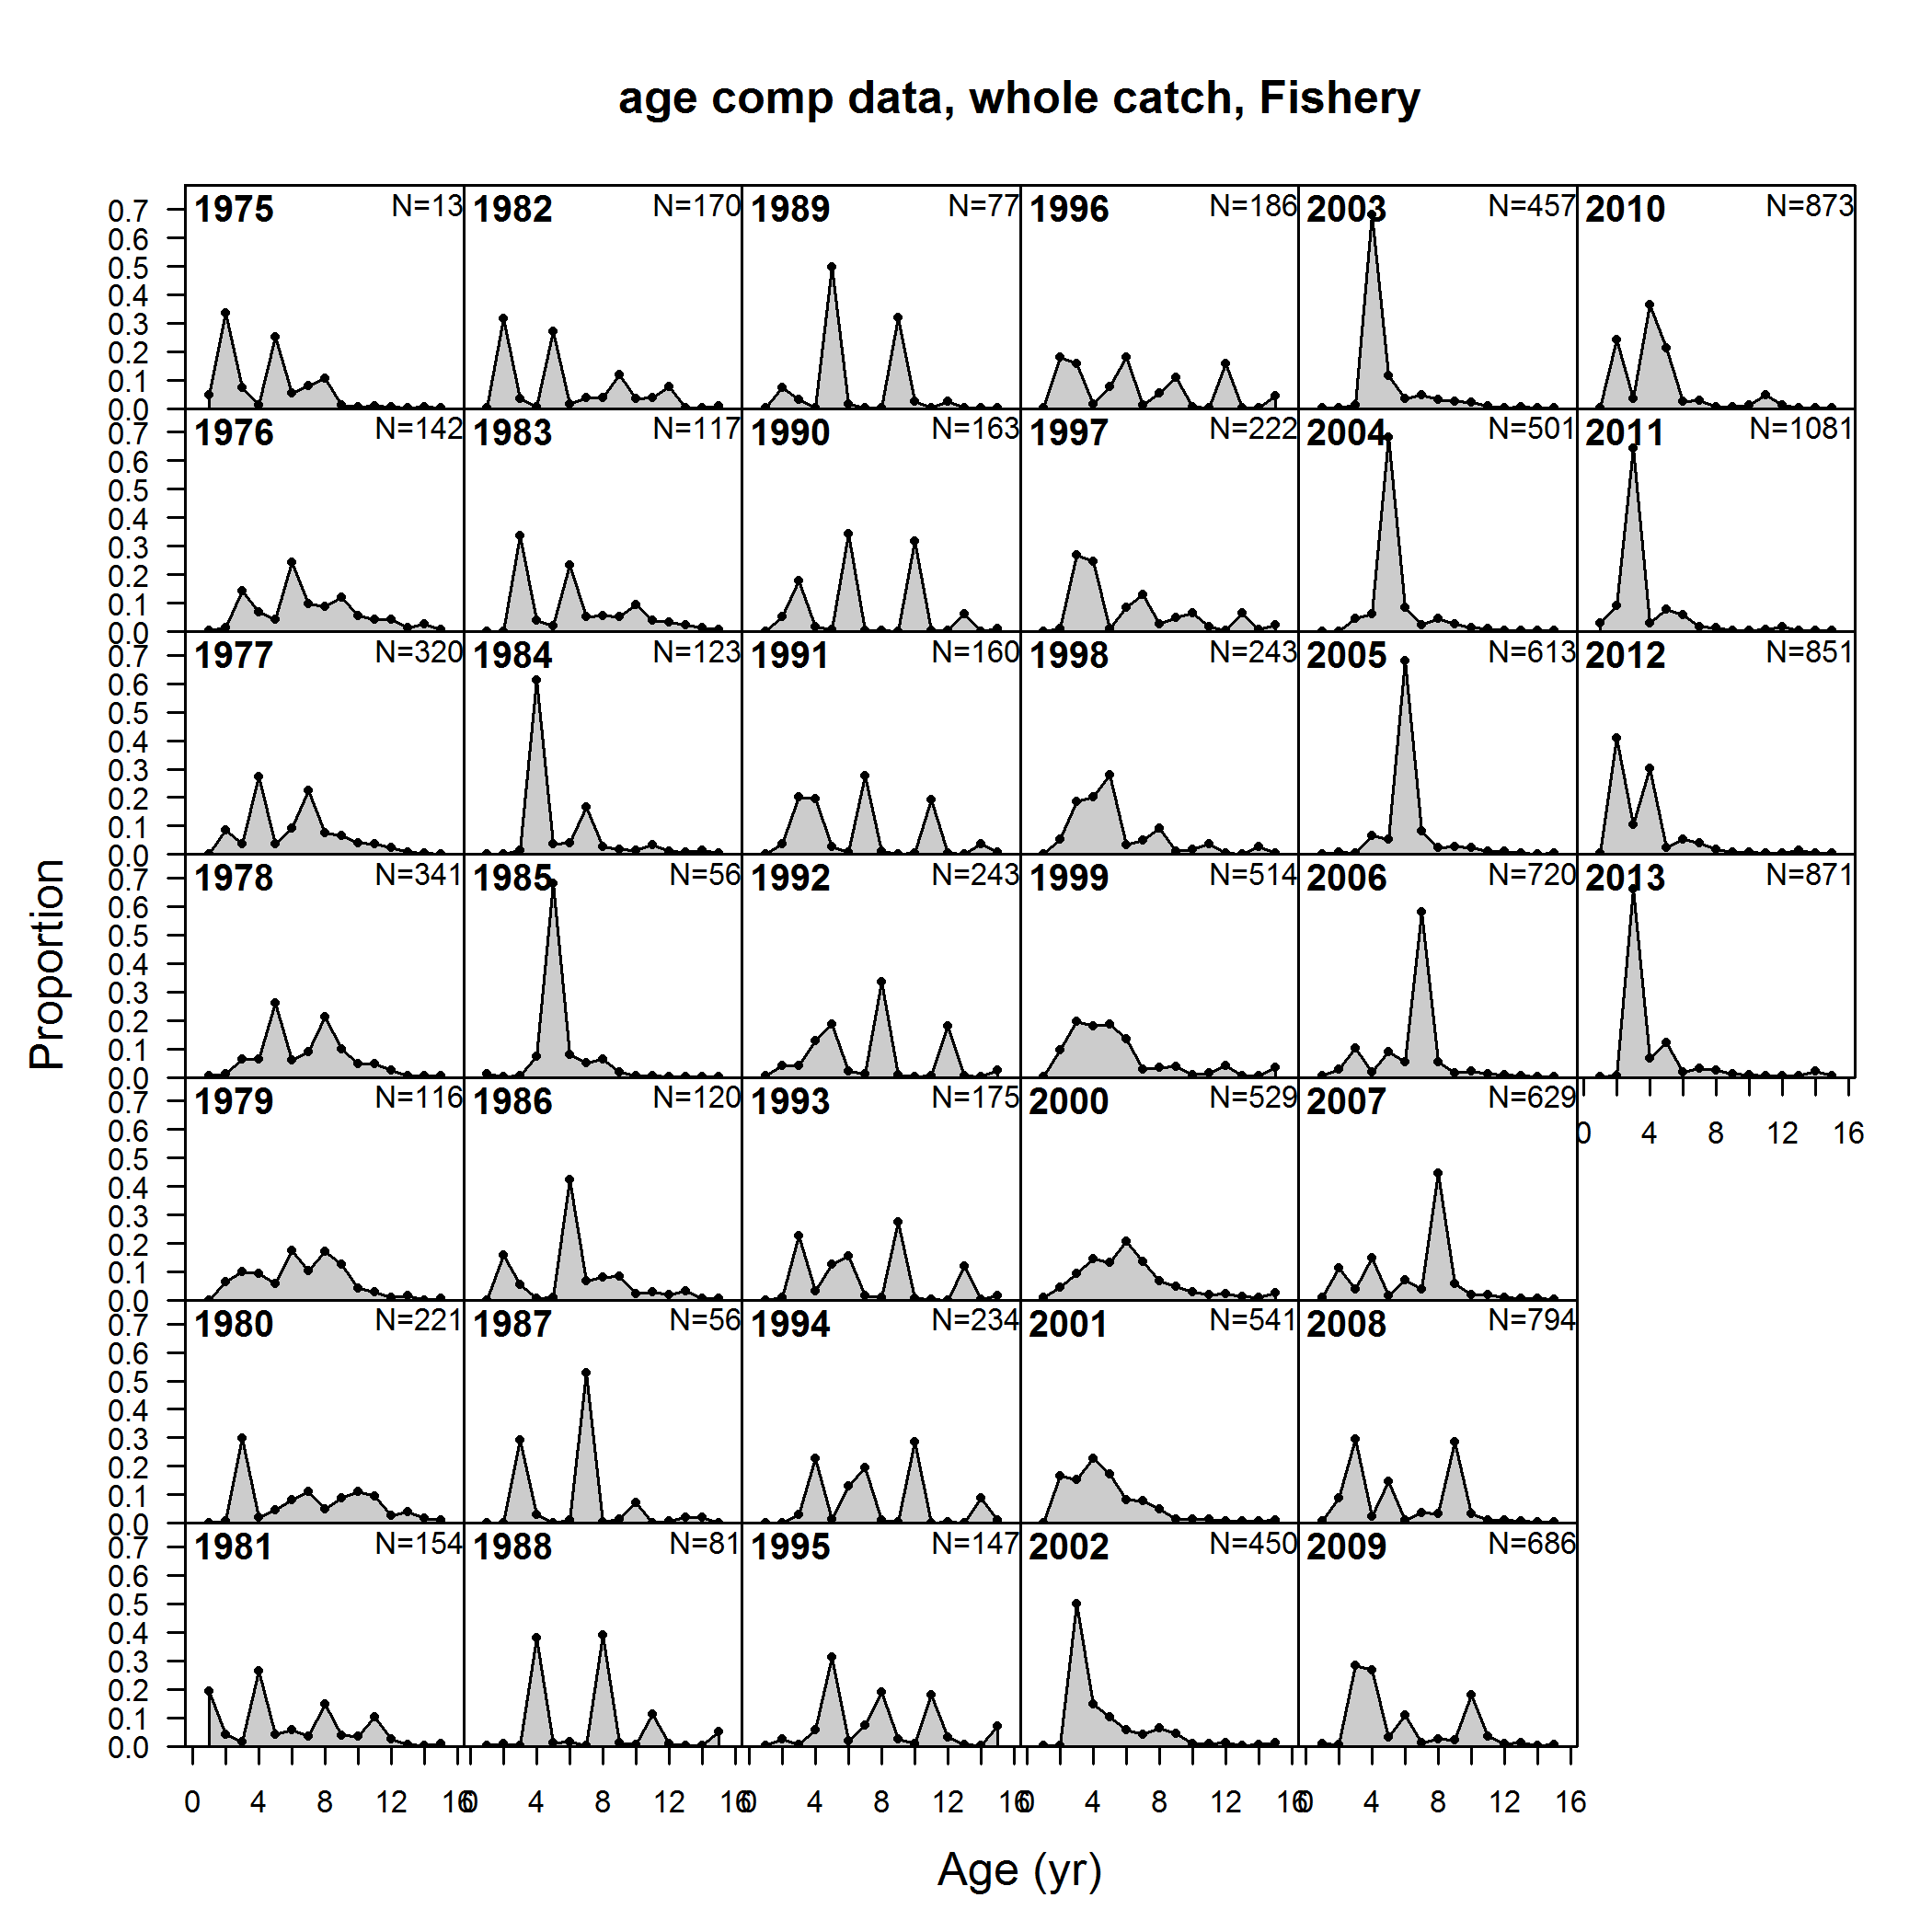
Example model: hake, age comps
source model: hake2014_simplified

Slide 37
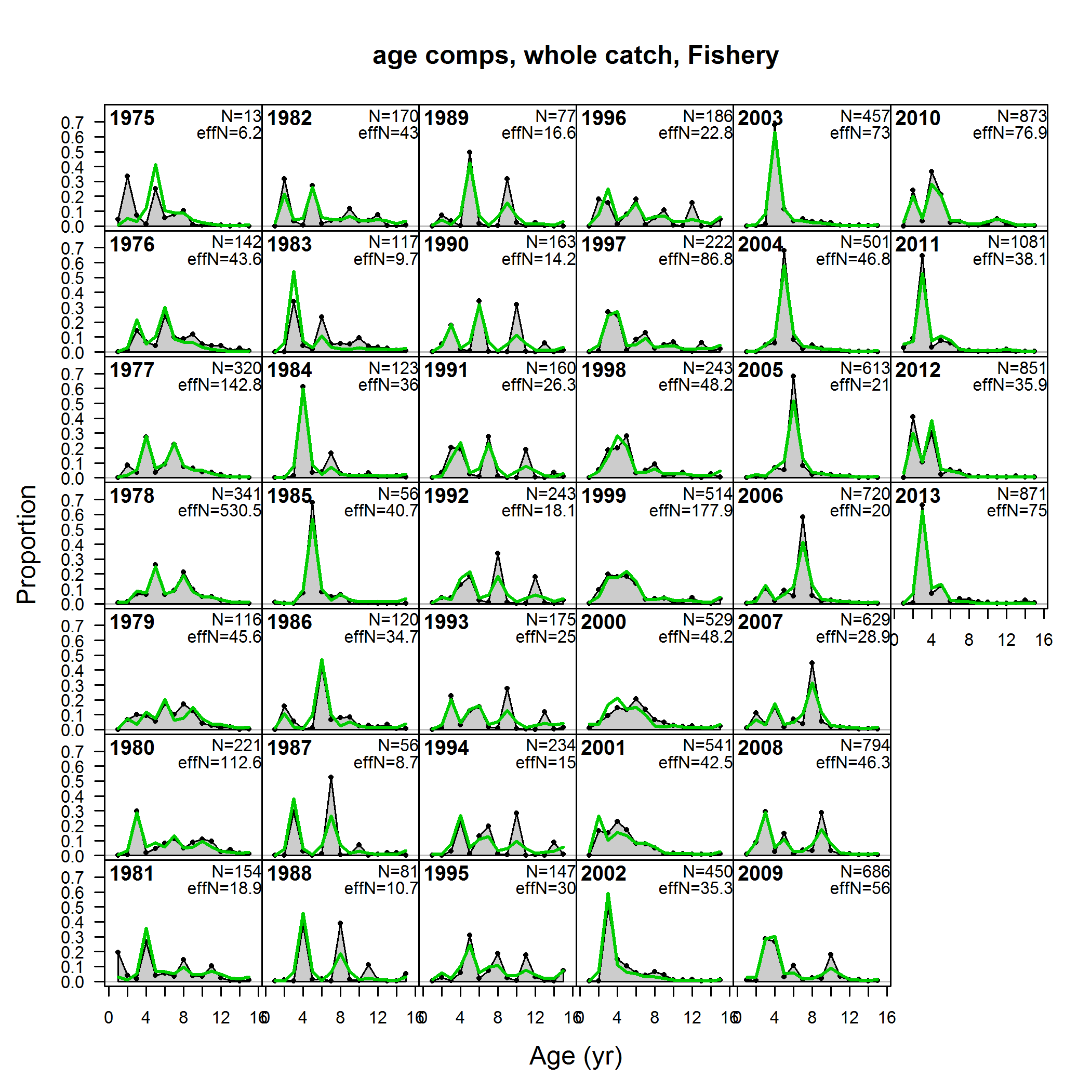
Example model: hake, age comps with fit
Informative age data.
Weights needed to convert total catch to numbers at age removed
source model: hake2014_simplified

Slide 38
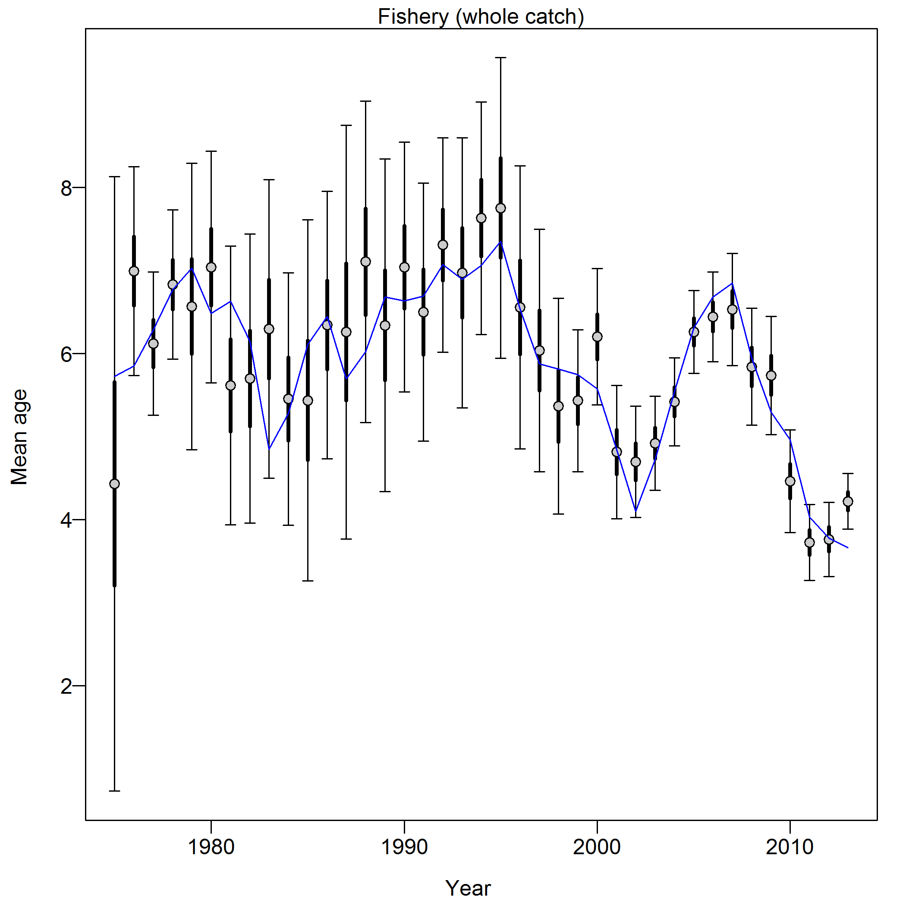
Example model: hake, new data weighting info
"Francis Weights - age: Fishery: 0.1098 (0.0717-0.2155)"
Thick intervals: expected variability in mean from current sample sizes
Thin intervals: expected variability in mean from alternative sample sizes
source model: hake2014_simplified

Slide 39
Timing issues

Slide 40
Timing issues
beginning of year vs. mid-year values
seasonal models
birth season
fleet timing (not currently connected to growth)
All this is changing in SS version 3.3
observations will be associated with month
settlement time replaces birth season
ask Rick Methot about the future

Slide 41
Advanced topics

Slide 42
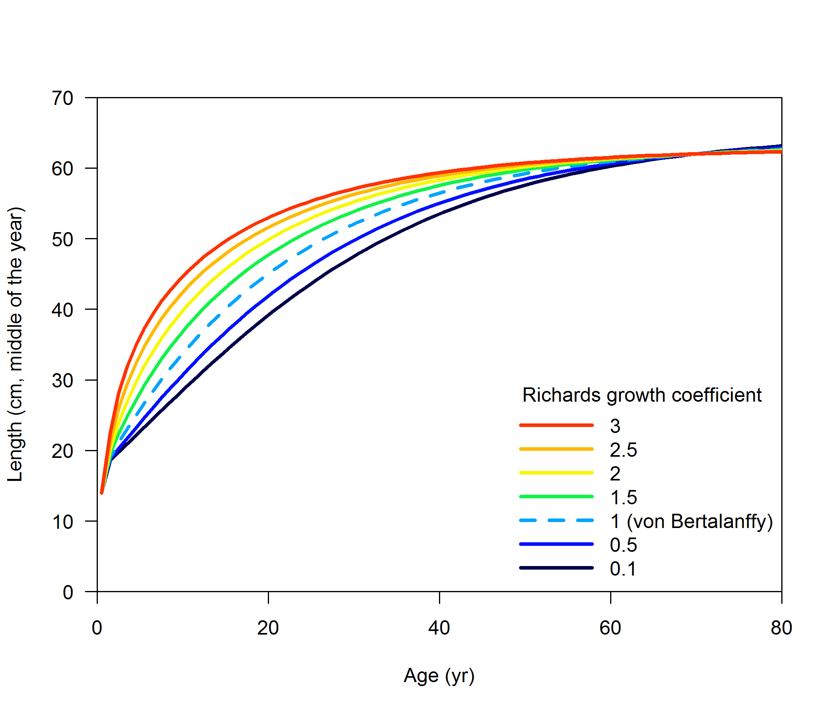
Alternatives to von Bertalanffy: Schnute/Richards
2 # GrowthModel: 1=vonBert with L1&L2; 2=Richards with L1&L2; 3=age_speciific_K; 4=not implemented
source model: extra_stuff/rockfish_simulation_richards_profile

Slide 43
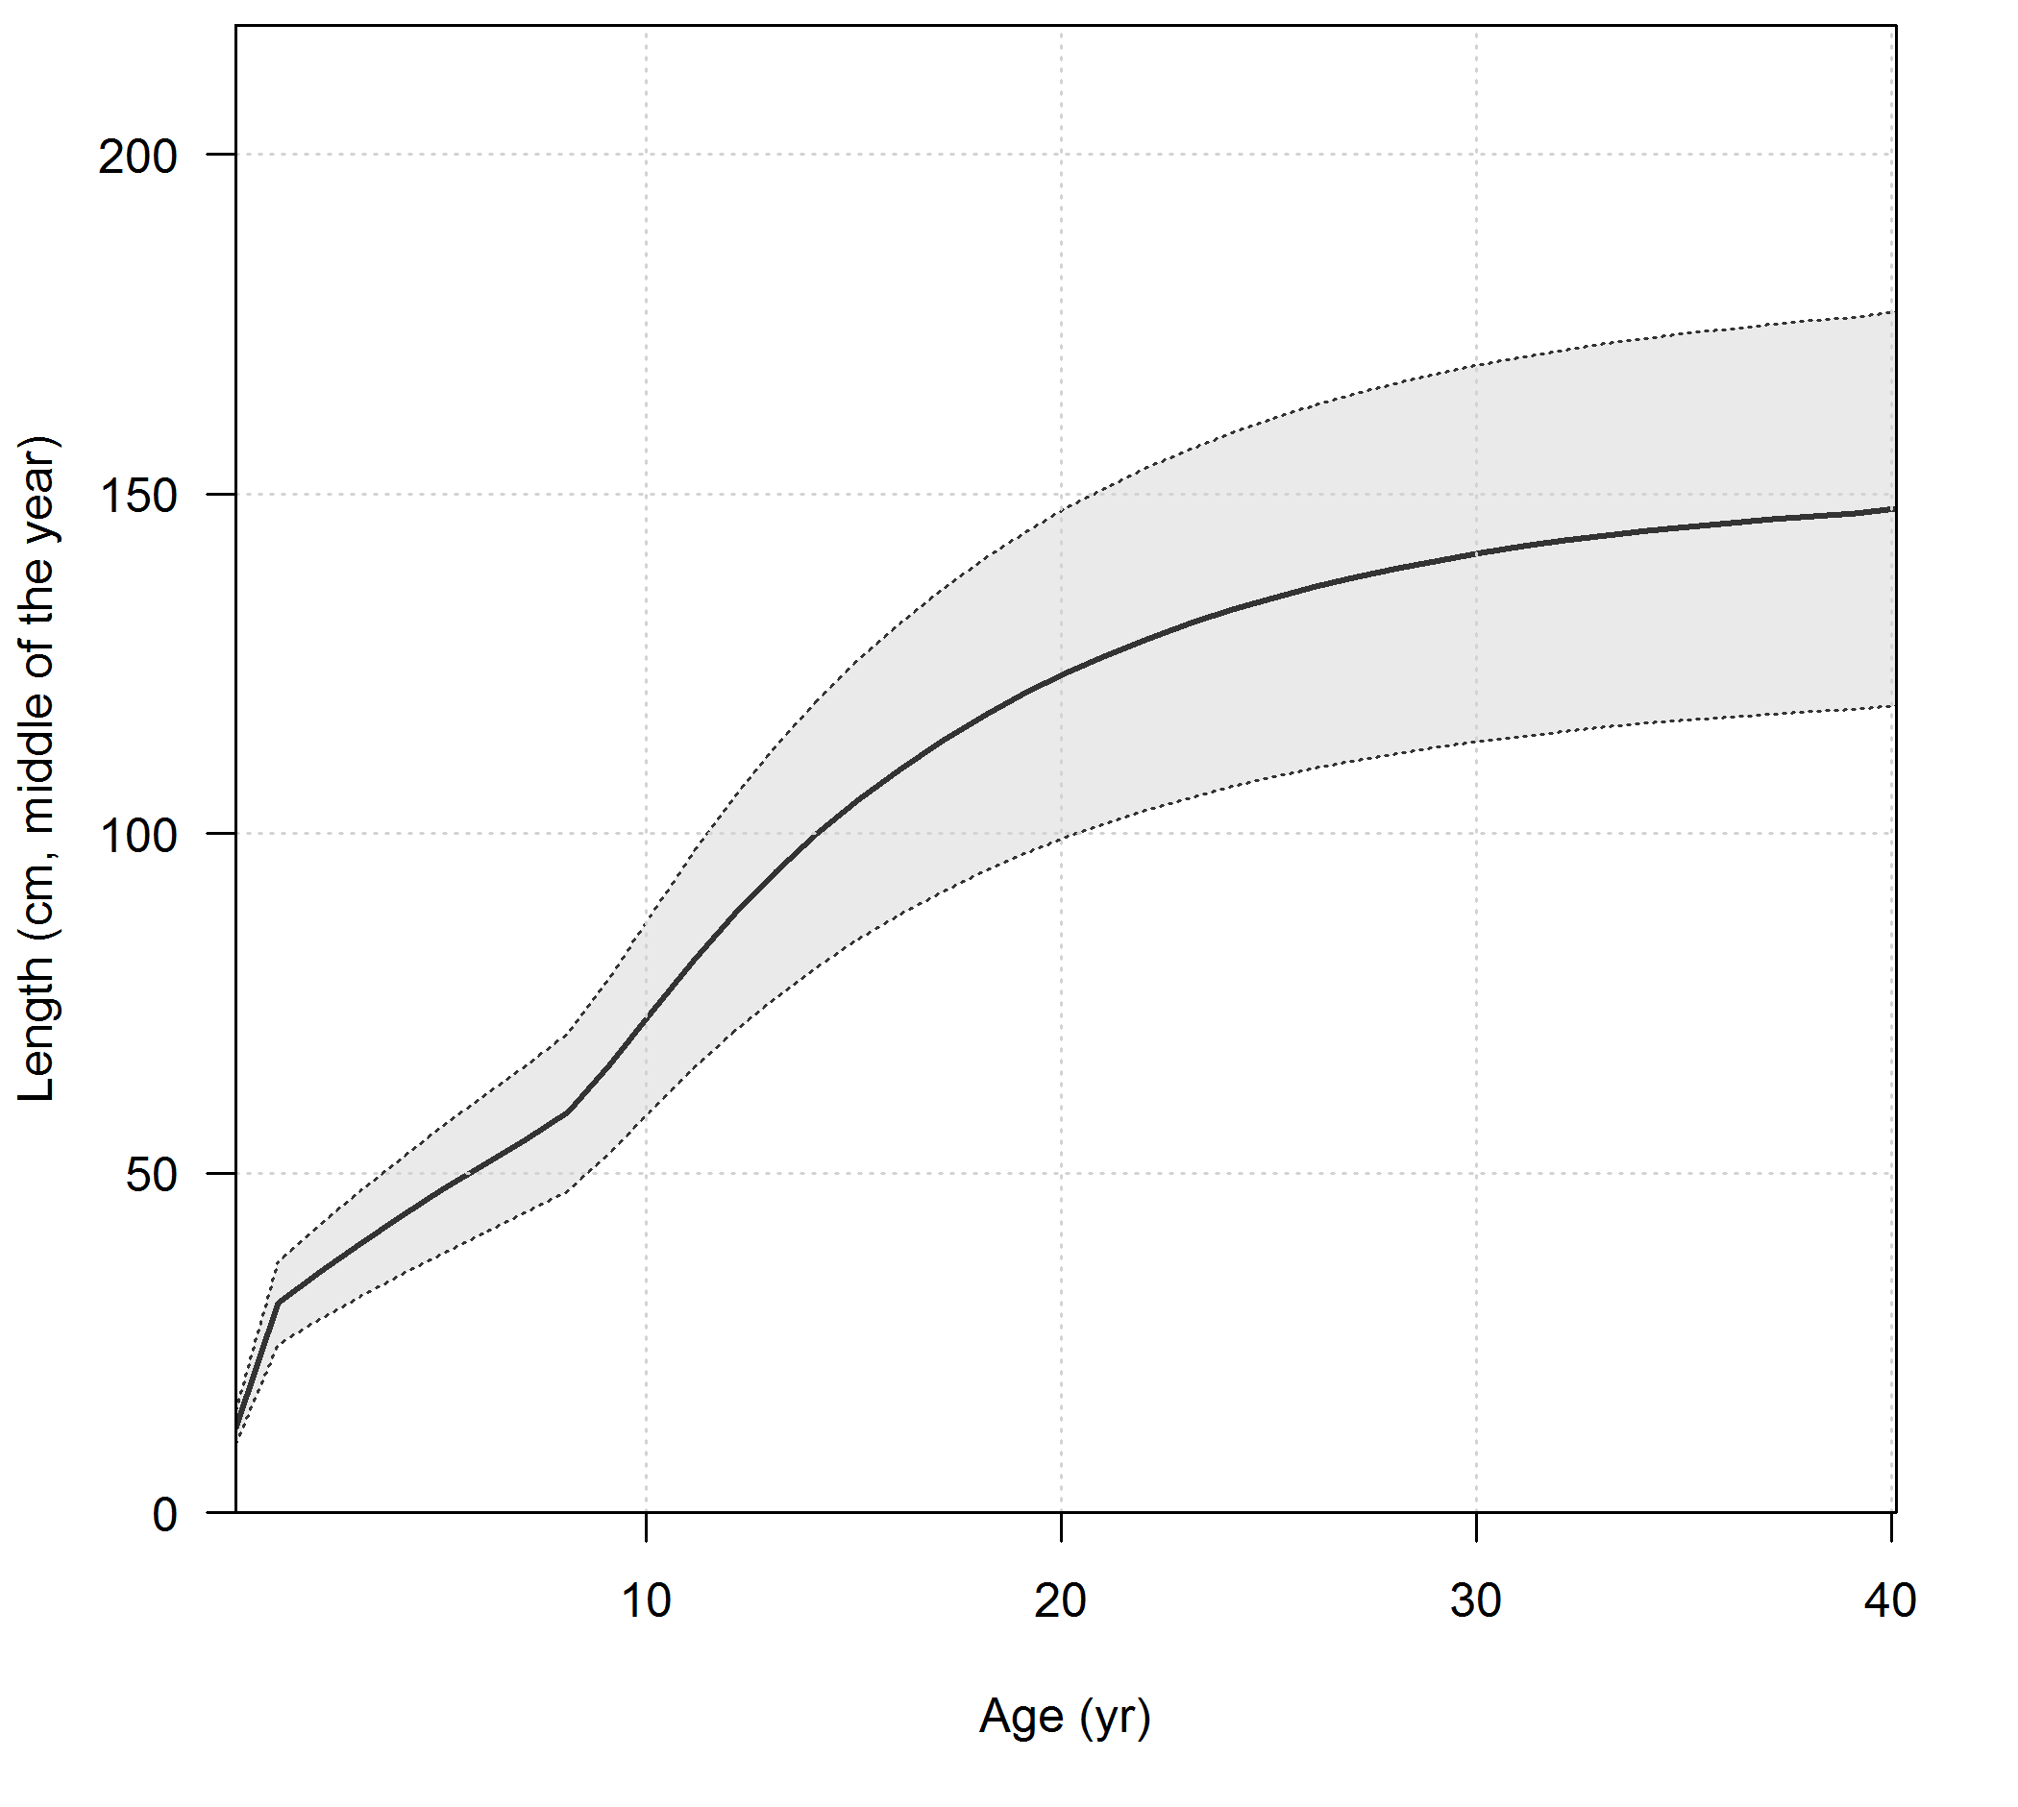
Alternatives to von Bertalanffy: age-specific k
source model: bigeye tuna model from Rishi Sharma (not in shared set)

Slide 44
Alternatives to von Bertalanffy: age-specific k
3 # GrowthModel: 1=vonBert with L1&L2; 2=Richards with L1&L2; 3=age_speciific_K; 4=not implemented
1 #_Growth_Age_for_L1
999 #_Growth_Age_for_L2 (999 to use as Linf)
4 # number of K multipliers to read
1 8 9 10 # ages for K multiplier
...
#_growth_parms
#_LO HI INIT ... # LABEL
0.075 2 0.8 ... # NatM_p_1_Fem_GP_1
-3 3 0.4 ... # NatM_p_2_Fem_GP_1
1 45 30.374 ... # L_at_Amin_Fem_GP_1
120 170 150.913 ... # L_at_Amax_Fem_GP_1
0.05 0.5 0.332 ... # VonBert_K_Fem_GP_1
-5 5 0.452 ... # Age_K_Fem_GP_1_a_1
-5 5 2 ... # Age_K_Fem_GP_1_a_8
-5 5 1.25 ... # Age_K_Fem_GP_1_a_9
-5 5 1.112 ... # Age_K_Fem_GP_1_a_10
0.05 0.25 0.1 ... # CV_young_Fem_GP_1
0.05 0.25 0.1 ... # CV_old_Fem_GP_1
Ask Juan Valero or Rishi Sharma

Slide 45
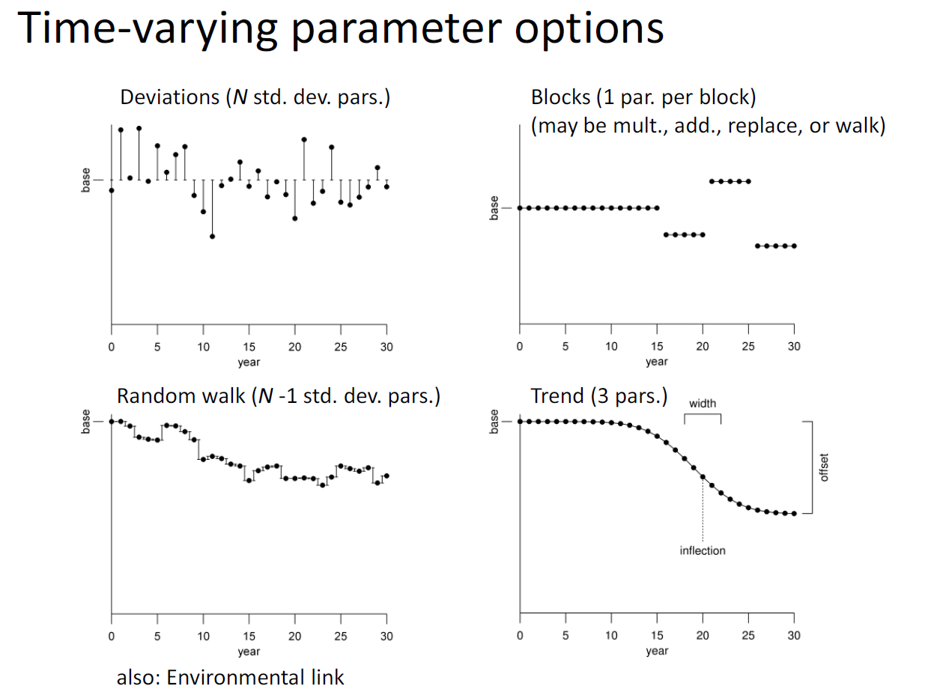
Time-varying growth: annual effects
Any growth parameter can be time-varying with any of the generalized options included in SS
source: User Manual for Stock Synthesis (v3.24s), page 91

Slide 46
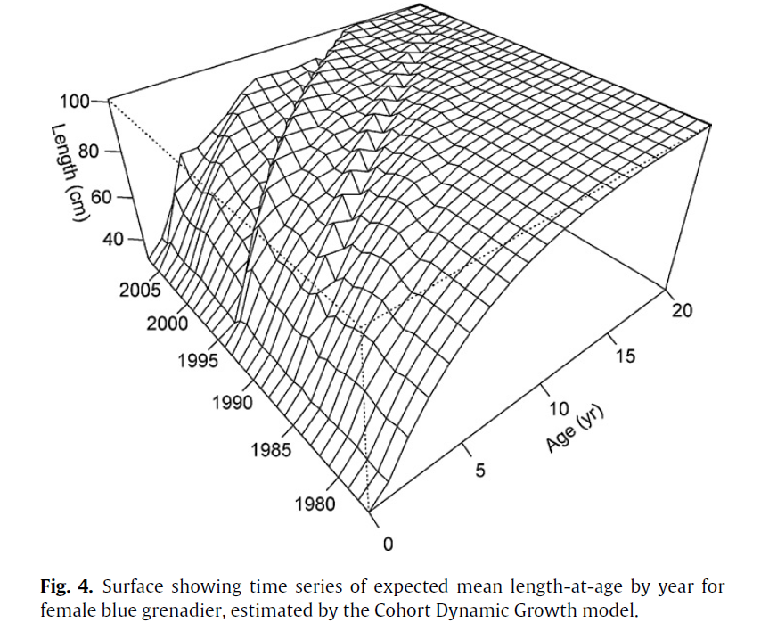
Time-varying growth: cohort-specific effects
Ask Athol Whitten
More on this at 8am on Friday
source: Whitten et al. (2013)

Slide 47
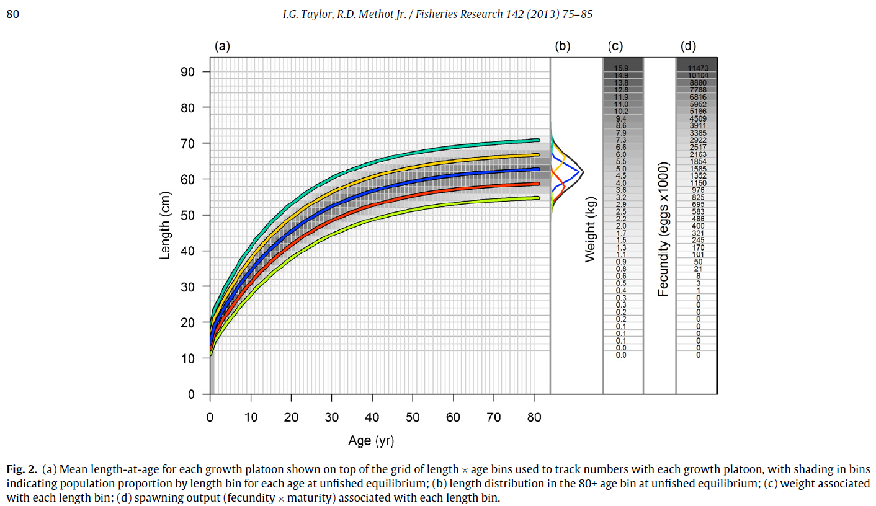
Growth platoons
1 #_N_Growth_Patterns
5 #_N_Morphs_Within_GrowthPattern
1 #_Morph_between/within_stdev_ratio (no read if N_morphs=1)
-1 1 1 1 1 #vector_Morphdist_(-1_in_first_val_gives_normal_approx)
source: Taylor and Methot (2013)

Slide 48
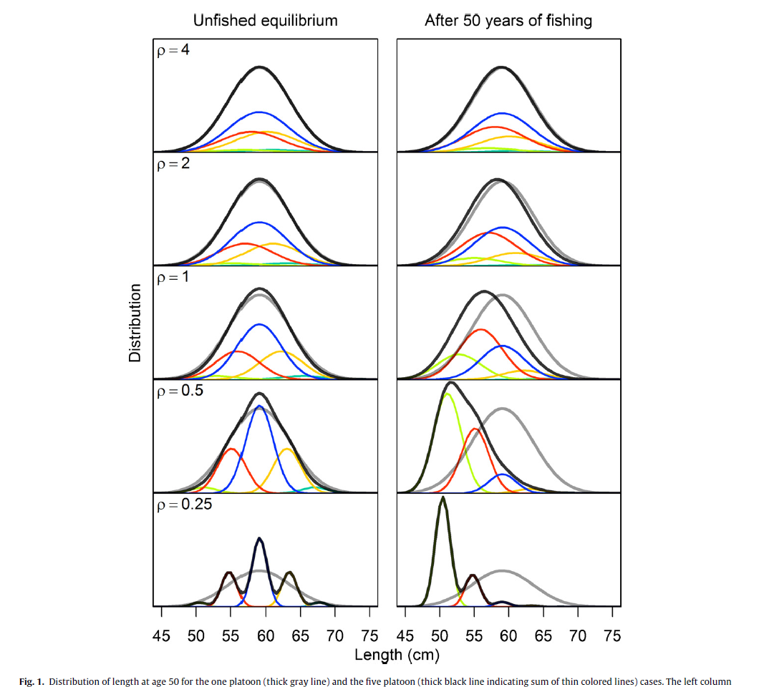
Growth platoons
Easy to implement
Model runs slower
Please try it out
source: Taylor and Methot (2013)

Slide 49
Growth morphs/patterns
Generalization of sex-specific growth
Can have sexes within each growth morph
Can have platoons within each growth morph
Not yet widely used
Please try it out

